Slide 1


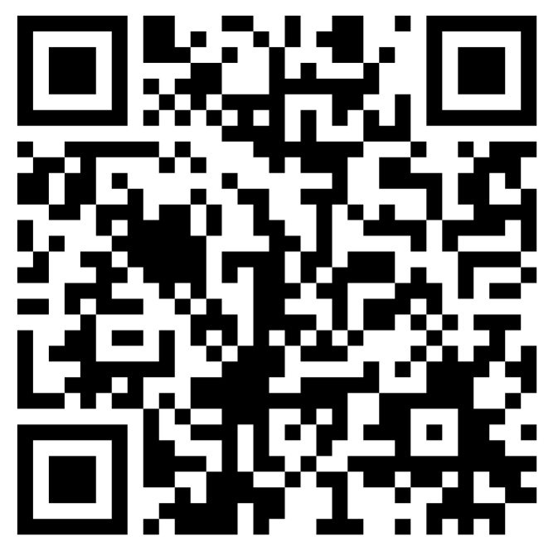
Calvary Kids Monthly Family Handout
Calvary Kids Is A Joyful And Safe Community, Where Every Child Is Celebrated, Experiences God’s Love, And Grows In Their Curiosity Of Who Jesus Is.
Calvary Kids Pre-Check
Memory Verse July
“Never will I leave you; never will I forsake you.” Hebrews 13:5
July Bible Story Theme: Braving the Wilderness
Monthly Summary: In July, we discover that God is always with us, even during difficult, lonely, or uncertain times. We begin with Hagar in the Wilderness (Genesis 16; 21), where Hagar learns that God sees her and cares for her wherever she is. Next, Elijah and God's Voice (1 Kings 19:1–18) teaches us that God often speaks in gentle ways and guides us when we listen closely. Finally, David Hiding in a Cave (Psalm 63) reminds us that even when life feels dark or scary, God is our refuge, strength, and source of hope. Throughout these stories, children will learn that God never leaves us and is always with us on every adventure.
Family Discussion Questions
Have you ever felt alone or afraid?
How does talking to Jesus help you during hard moments?
How does it make you feel knowing God is always with you, wherever you go?
Family Activity
Wilderness Walk
Take a family walk through a local park, neighborhood trail, or your backyard. As you walk, look for signs of God's creation around you. Pause occasionally and ask, "What do you notice about God from what you see?" End your walk by thanking God for always being with your family wherever you go.
Calvary Kids Upcoming Events July 2026
July 11th & 12th – Move Up Weekend Calvary Kids
July 12th – Move Up Sunday C7
July 25th – Men’s Breakfast
July 28th – Mochas and Monkey Bars

