Slide 1
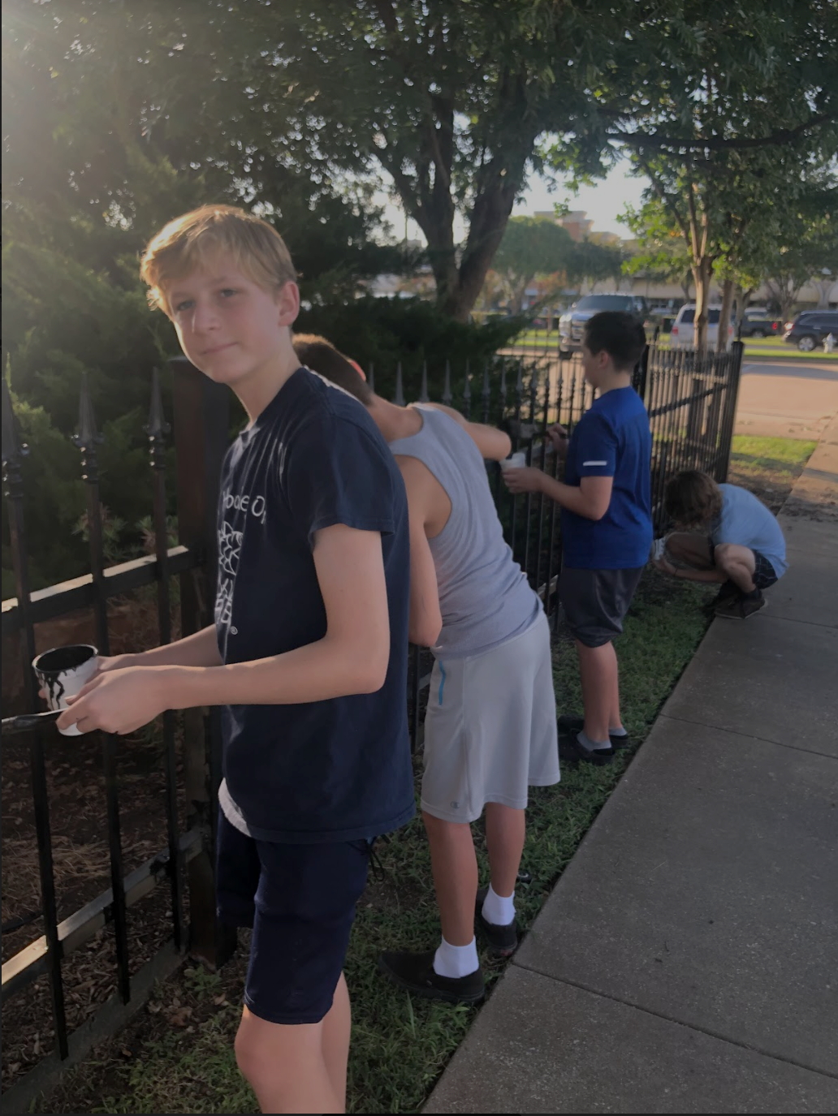
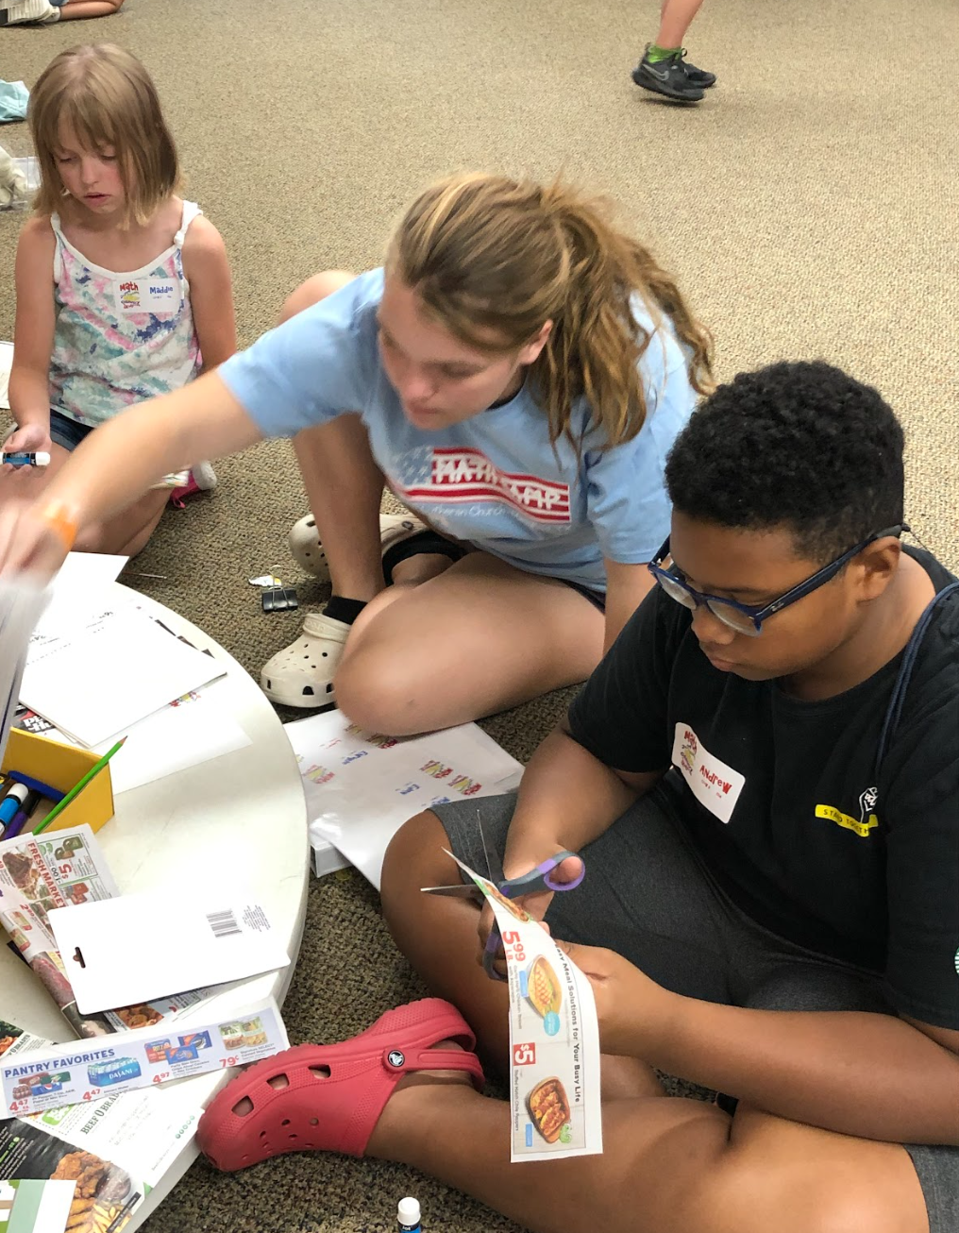
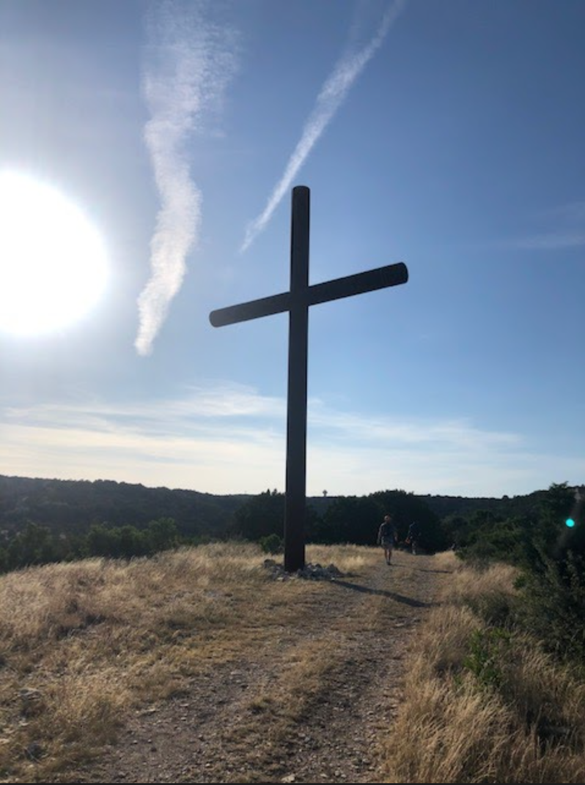
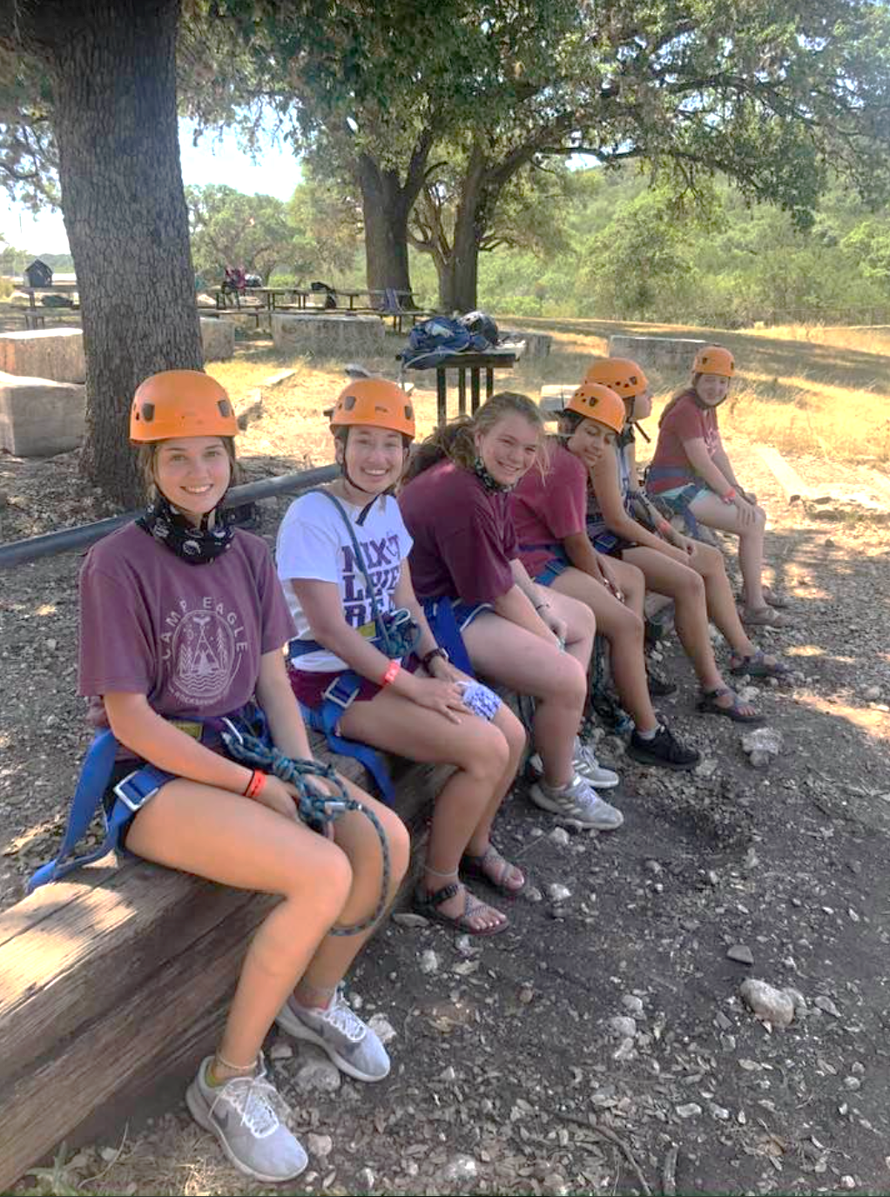
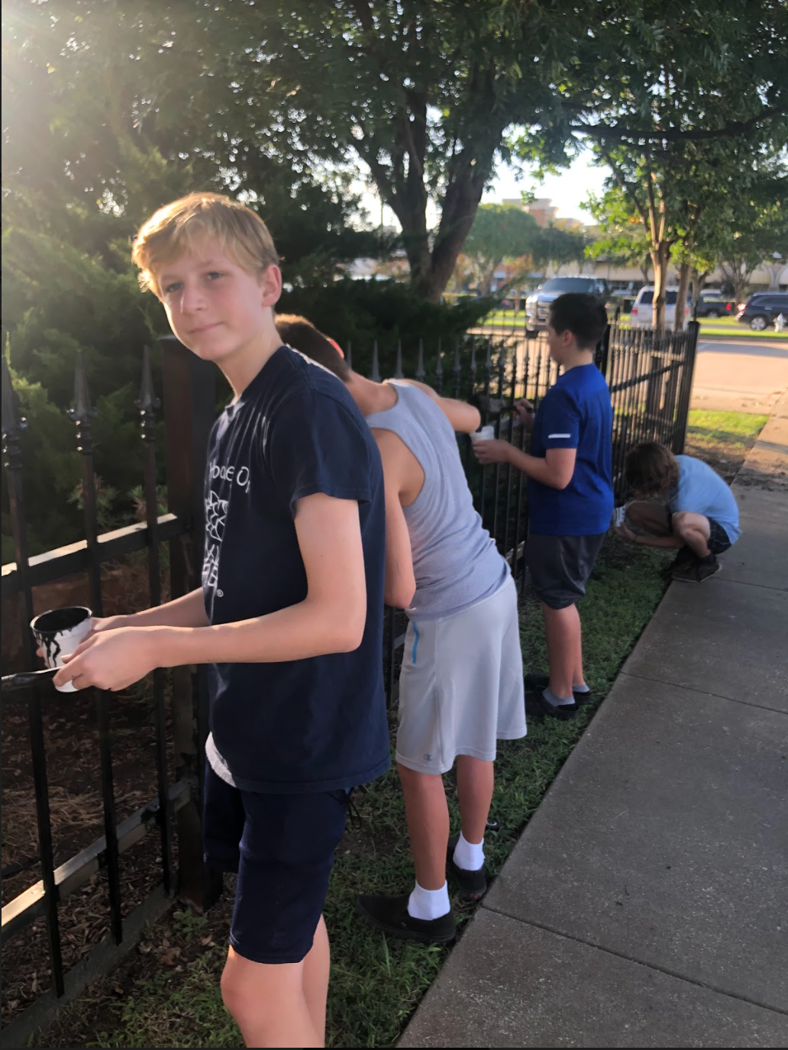
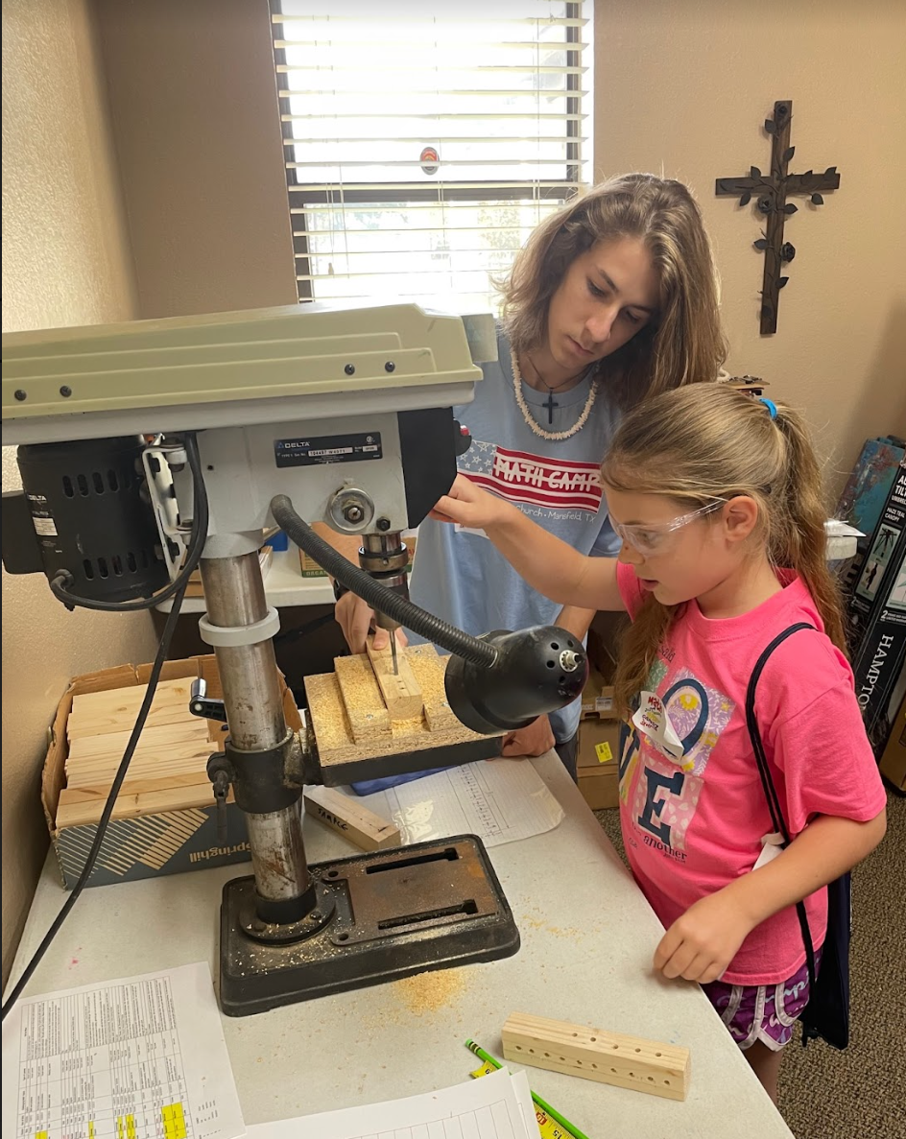
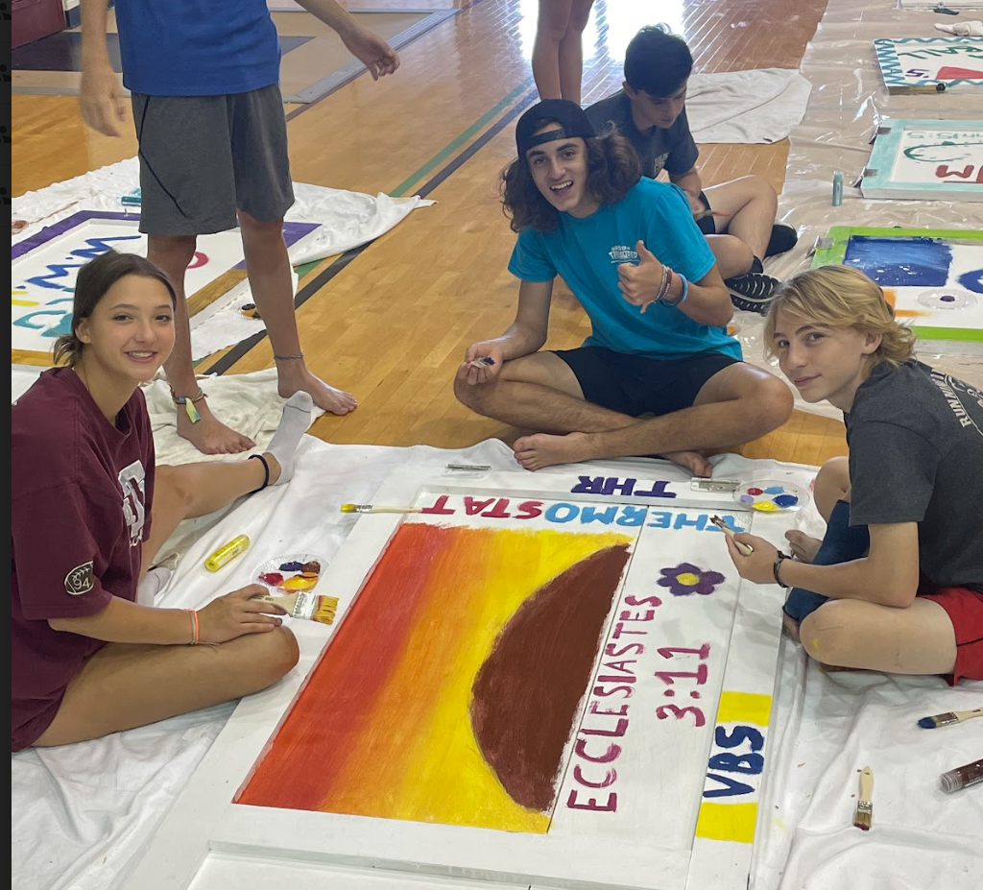
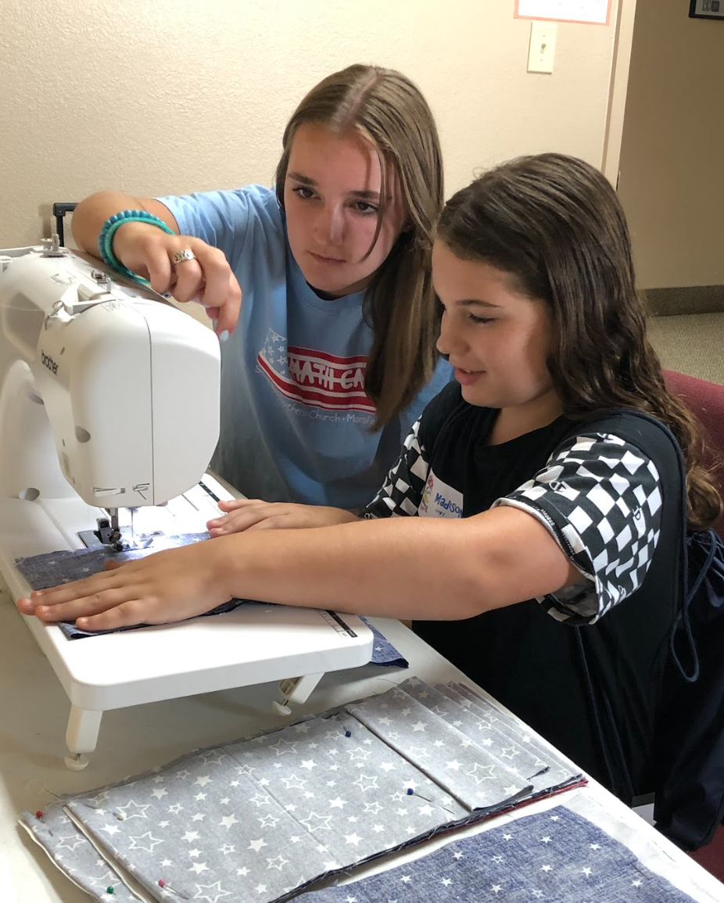
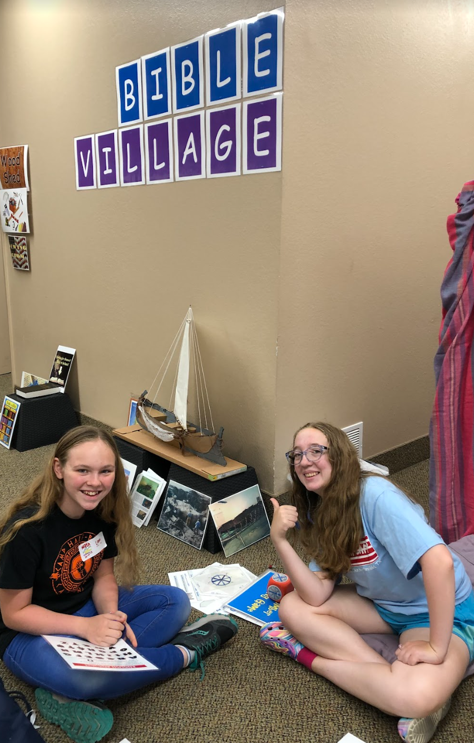



YOUTH MINISTRY
What’s going on EVERY* week?
WHEN |  | WHAT | WHO | WHERE
SUN | 9:30a | Sunday Small Groups | 7th-8th, HS | Youth Building
 | 12:15-1:30p | Youth Leadership Council (YLC) (meets 2 times a month to build youth leadership experience) | YLC | Youth Building
WED* | 6:30-8:00p | Confirmation/Foundations of Faith | 7th-8th | Sanctuary
 | 7:00-8:30p | HS Small Group Bible Study | HS | Youth Building (HS)
* During Thanksgiving / Christmas / Spring Break – No Wednesday activities
HS – High School (9th-12th)
AUGUST | SEPTEMBER | OCTOBER | NOVEMBER | DECEMBER
YOUTH ACTIVITIES
Worship
Bible Study/Small Group
High Impact
Leadership Experience
Service
Fellowship
Fundraising
Church/Community
YLC Selection
Recess Retreat (7th-8th)
Women’s Shelter Blanket Project
College Care Packages
Beginning Confirmation Blessing
Pathfinders >>>>>>>>>>>>>>>>> Faith Stories
Confirmation Service
Blessing of the Backpacks/Schools
Pumpkin Patch
Drive Thru Nativity
Events at the Patch
Christmas Party (7th-HS)
PNO
PNO
Youth Ministry at a Glance
JANUARY | FEBRUARY | MARCH | APRIL | MAY | JUNE | JULY
Reset Retreat (HS)
College/HS Broomball
Shadow Drama Practice >>>>>>
Shadow Drama
(Good Friday)
Senior Sunday/ Celebration
HS Service Event
Eggstravaganza
Camp
Eagle
VBS
MATH CAMP
PNO
PNO
Mission Trip

Slide 2
2025 | Aug
 | Sep
 | Oct
 | Nov
 | Dec
2026 | Jan
 | Feb
 | Mar
 | Apr
 | May
 | June
 | Jul
Youth Leadership Council is a group of youth who actively lead in selecting/planning/ carrying out of Youth Ministry activities/service. To observe YLC applicants' leadership in action, each YLC applicant serves as a MATH CAMP Coach and participates in individual/group interviews.
Blessing of the Backpacks is an invitation to all students, administrators, teachers, school staff to bring their backpacks and participate in a special blessing to start the school year.
Beginning Confirmation Blessing is a time when beginning Confirmands and their parents start the Confirmation experience with a blessing and fellowship.
Youth Ministry
Worship
Bible Study/Small Group
High Impact
Leadership Experience
Service
Fellowship
Fundraising
Church/Community
Pathfinders is a 'ready to be confirmed' group who will spend the last few months before Confirmation getting questions answered, affirming their faith in God, the Father/Jesus, the Son/Holy Spirit. All Pathfinders publicly confess their Faith Stories before their Confirmation.
Pumpkin Patch (mid-September through October) offers an opportunity to connect with our community, introduce them to St. John while providing truckloads of pumpkins/gourds! Funds raised go toward Camp Eagle, Youth Gathering (every 3 years) and Youth Ministry scholarships.
PNO (Parent Night Out) offers parents a night out each month knowing that their children will enjoy 3 hours of activities in a fun and safe environment. Funds raised go toward sending our youth to Camp Eagle, Youth Gathering,...
Saturday Events at the Patch is a fun community outreach that comes alongside Youth Ministry's Pumpkin Patch. Each Saturday in October there is a new fun activity such as a petting zoo, bounce houses,...
Recess Retreat is a gathering of 7th and 8th graders from across our North.Texas LCMS (Lutheran Church Missouri Synod) congregations for an overnight adventure in worship, fun and fellowship.
Women's Shelter Blanket Project is a Confirmation service project where 'The Grandmas' work with our Confirmands to cut and tie fleece blankets as a caring gift for others.
Confirmation is a special worship service that culminates the Confirmation experience and where each Confirmand affirms their faith.
College Care Packages service project is where our Confirmands package snack and small non-perishable items to be sent to our college student right before exams to remind them they are loved and prayed for.
Drive Thru Nativity is a community outreach in which the story of Jesus' birth is told. Cars line up and slowly drive through to see key scenes in the events leading up to Jesus' birth...real actors, real animals and a real present God!
Youth Christmas Party is fellowship time for our youth and their friends. It is a time of fun, food, saran balls, and white elephant gifts, but also a time to remember our most precious gift of all...Jesus!
College/HS Broomball is an event that welcomes our college students to re-connect with our HS students. What fun they have before heading back to their studies!
Every Week!
Reset Retreat is a gathering of high school youth from across our North Texas LCMS (Lutheran Church Missouri Synod) congregations for an overnight adventure in worship, fun and fellowship.
Sunday Bible Study/Small Group is a weekly Sunday morning Bible Study and exploration of challenges faced by our youth and how scripture can be applied to real life.
High School Service Event is one that provides true service to our community. In 2024 this happened with 'Pack a Purse' for the Metroplex Women’s Clinic! We will repeat this act of service somehow as it impacted 'receivers' and 'givers'!
Shadow Drama Practice prepares our youth to tell Jesus’ story on Good Friday, sing the songs, handle backstage and orchestrate the tech!
7th-12th graders work together...have fun together...for some, new relationships form!
Youth Leadership Council (YLC) is a group of youth who actively lead in selecting/planning/carrying out of Youth Ministry activities/service that complement St. John’s mission. Each YLC applicant is interviewed by YLC mentors before determining the Council for the upcoming school year.
Eggstravaganza is community outreach in which Jesus' story is shared, the children hunt for eggs and we are reminded of God's love for us!
Shadow Drama is a youth-led worship using a dramatic reading of the Gospel of John which is the backdrop for actors/singers/tech to bring to life Jesus’ great love for us. How joyous our Easter will be when Jesus’ resurrection is revealed!
Confirmation is a weekly exploration of the basics of the Christian faith in which our youth learn about God's truths and promises as well as the LCMS doctrine. This is also the time our youth grow their relationship with their Savior as well as with each.
Senior Sunday celebrates our youth who have graduated from high school to a new adventure!
Senior Celebration is a time when graduating Seniors and their families come together to celebrate great accomplishment and movement to God's plan for each!
HS Small Group Bible Study is a weekly youth-led/adult-supported study for HS youth to learn about the wisdom and teachings the Bible gives us as they grow in faith.
Camp Eagle is a camp in south central Texas where our youth annually go and develop deeper relationships with Jesus and with each other. This week is a life changer!
VBS (Vacation Bible School) is an opportunity for our youth to connect with our community as they assist with VBS stations or serve as Crew Leaders.
Math Camp is an opportunity for our high school youth to be a Coach for entering 3rd-8th graders. Coaches have an opportunity to lead, to come along side, to encourage and to have fun themselves with exploratory and fun math related activities.
Youth Gathering (YG) happens every 3 years. It is where tens of thousands of LCMS youth come together for a glorious time of worship, study, growing closer to Jesus and each other.
Mission Trip is open to our youth have the opportunity to serve others in another country.

