Slide 1

Week 3

Slide 2

How do I incorporate lament into my personal prayer life?

Slide 3
Study the Psalms of Lament (List can be found in your workbook)

Slide 4
Study the Psalms
of Lament
GABCWomen’s Bible Study Handbook
a)
Method:Psalms (pg. 14) by Lisa Harper
b) Method: Meditate (pg. 22) by Jaime Cornelius
c)
Method: FLAP (pg. 23) by Debbie Stuart
d) Method: Homiletics (pg. 29) by Jan Burkhart
e) f)
Bible Study Applications (pg. 38)
Passage Study Worksheet (pg. 39)

Slide 5
Study the Psalms of
Lament
Read ALOUD Psalms of lament during your prayer time
(repetitively if necessary)
WRITE OUT a psalm of lament and put it somewhere you will see it.

Slide 6
Study the Psalms of
Lament
Ask yourself questions about that particular psalm:
a)What is the Psalmist feeling?
b)How does he express those feelings?
c)What does this Psalm teach me about God?
d)How does he show his faith in God?
e)Can I relate to any part of this Psalm? How? Why?
f)Did any verse stand out to me? Why?
g)Is the Holy Spirit prompting me to action through this Psalm?

Slide 7
Write your own
lament and…
Pray it out loud!
Keep it in a JOURNAL.
Be PERSISTENT!

Slide 8
Listen
to songs and hymns of
lament.
(see“additional resources on pg. 38)

Slide 9
How do I
incorporate lament
into my communal
prayer life?

Slide 10
How do I incorporate lament into my communal prayer life?
Find a COMMUNITY
PRAY together Encourage the
STUDY of a lament as a group.
Respond to community and world crises ﬁrst with LAMENT.

Slide 11
Teaching Children to Lament

Slide 12
Simplify what it is:
A Prayer to God for Help When I
(or Someone I love)
is hurting.

Slide 13
HELP method using…
HAND motions

Slide 14

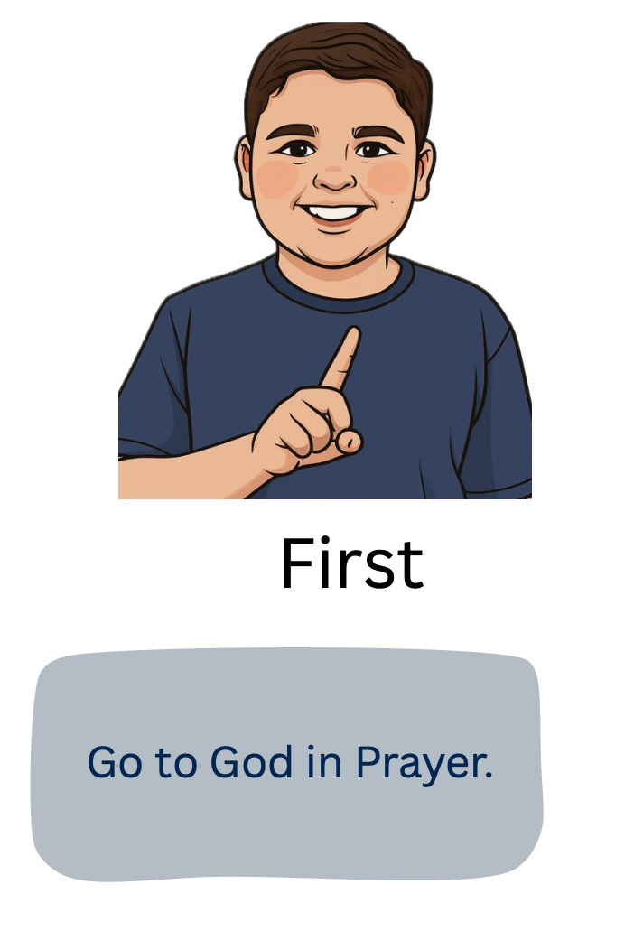

H- Head to God First

Slide 15
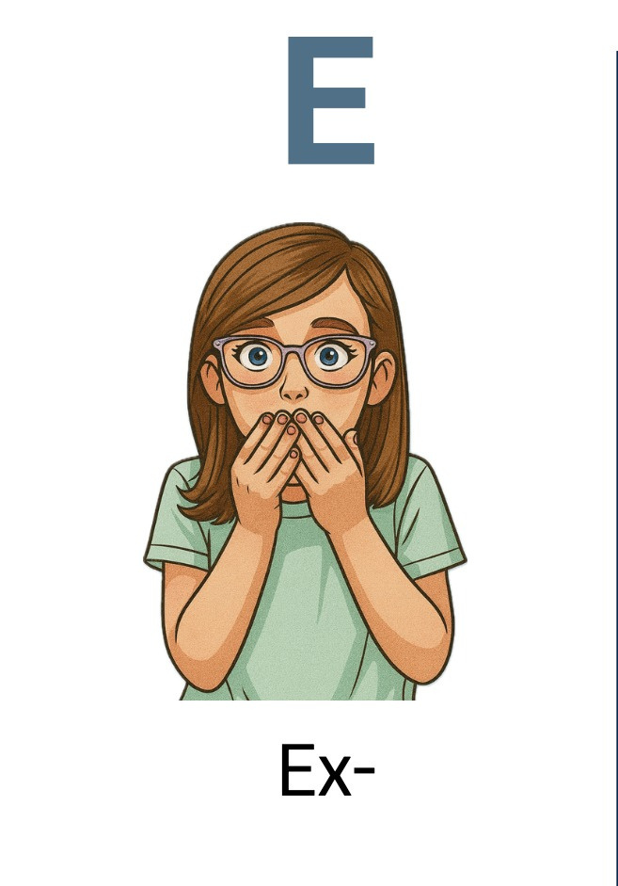
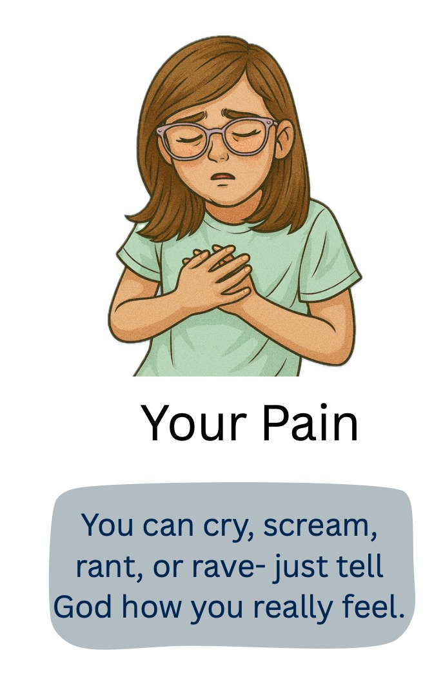

E- Express Your Pain

Slide 16


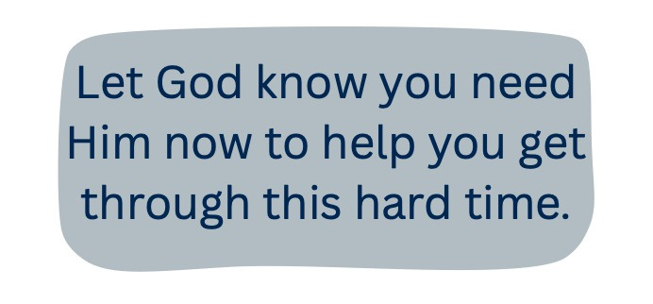
L- Lift Up Your Need for Help

Slide 17

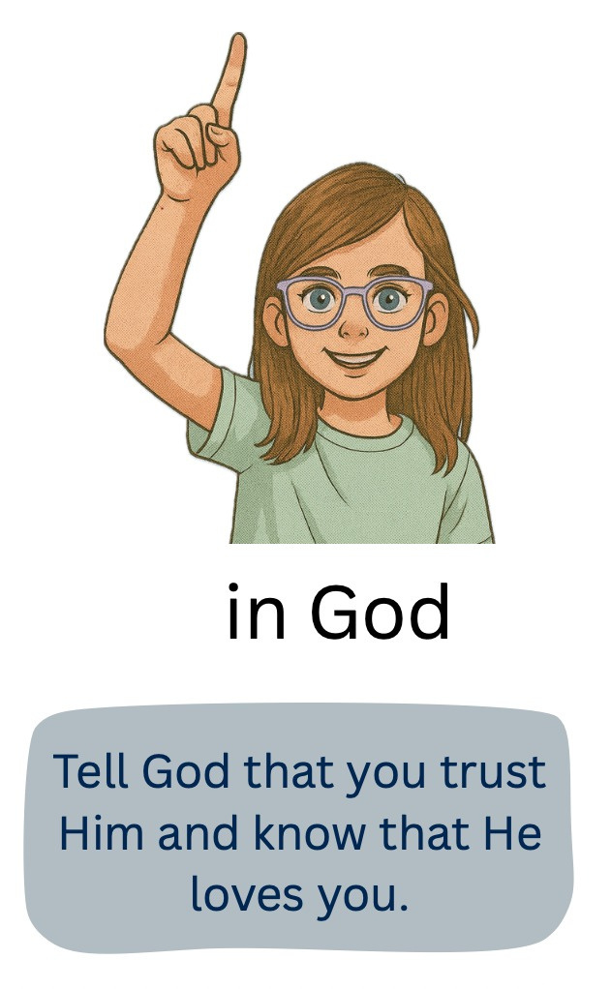

P- Put Your Trust in God

Slide 18
Younger Children:
Take each step slowly and help
apply the child’s
situation to each step
Older Children:
Explain each step and then allow them to
come up with their own
part of each step. Guide if needed.
Provide encouragement.

Slide 19
MODEL lament in personal times of difﬁculty and INVITE children to pray/lament with you.
GUIDED prayers of lament (especially helpful with very young children.

Slide 20
Read and teach stories of God’s FAITHFULNESS in difﬁcult times.
WHY??? Examples: Noah’s Ark
(Genesis 6:5-9:17)
Esther (Esther)
Jonah & the Whale (Jonah 1-3)
Daniel and the Lion’s Den (Daniel 6)
Paul Singing in Prison (Acts 16:16-40) ***

Slide 21
Where do I go
from here?

Slide 22
Thank you for
joining us!
Please text or e-mail me if you have ANY questions:
Leslie Bowers
leslielyles@me.com
318-446-2562

