Slide 1

Sorrow
sorrow

Slide 2
There are two types of sorrow.
Worldly Sorrow
GODLY Sorrow

Slide 3
GODLY SORROW:
A kind of wretchedness that can bring a repentant sinner to tears of GREIF.

Slide 4
Matthew 26
Peter Denies Jesus, and Weeps Bitterly

Slide 5
33 Peter answered and said to Him, “Even if all are made to stumble because of You, I will never be made to stumble.”

Slide 6
34 Jesus said to him, “Assuredly, I say to you that this night, before the rooster crows, you will deny Me three times.”

Slide 7
35 Peter said to Him, “Even if I have to die with You, I will not deny You!”

Slide 8
69 Now Peter sat outside in the courtyard. And a servant girl came to him, saying, “You also were with Jesus of Galilee.”

Slide 9
70 But he denied it before them all, saying, “I do not know what you are saying.”

Slide 10
71 And when he had gone out to the gateway, another girl saw him and said to those who were there, “This fellow also was with Jesus of Nazareth.”

Slide 11
72 But again he denied with an oath, “I do not know the Man!”

Slide 12
73 And a little later those who stood by came up and said to Peter, “Surely you also are one of them, for your speech betrays you.”

Slide 13
74 Then he began to curse and swear, saying, “I do not know the Man!”

Slide 14
Immediately a rooster crowed. 75 And Peter remembered the word of Jesus who had said to him, “Before the rooster crows, you will deny Me three times.”

Slide 15
So he went out and wept bitterly.

Slide 16
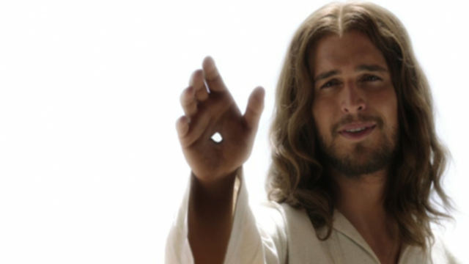

Slide 17
2 Corinthians 7
10 For godly sorrow produces repentance leading to salvation, not to be regretted;

Slide 18
but the sorrow of the world produces death.

Slide 19
James 4:6-9
That is why Scripture says:
“God opposes the proud
but shows favor to the humble.”

Slide 20
7 Submit yourselves, then, to God. Resist the devil, and he will flee from you.

Slide 21
8 Come near to God and he will come near to you. Wash your hands, you sinners, and purify your hearts, you double-minded.

Slide 22
9 Grieve,mourn and wail.

Slide 23
Change your laughter to mourning and your joy to gloom.

Slide 24
10 Humble yourselves before the Lord, and he will lift you up.

Slide 25


Slide 26
2 Samuel 11
2 One evening David got up from his bed and walked around on the roof of the palace.

Slide 27
From the roof he saw a woman bathing. The woman was very beautiful,

Slide 28
4 Then David sent messengers to get her. She came to him, and he slept with her.

Slide 29
5 The woman conceived and sent word to David, saying, “I am pregnant.”

Slide 30
14 In the morning David wrote a letter to Joab and sent it with Uriah.

Slide 31
15 In it he wrote, “Put Uriah out in front where the fighting is fiercest. Then withdraw from him so he will be struck down and die.”

Slide 32
Uriah the Hittite died.

Slide 33
27 After the time of mourning was over, David had her brought to his house, and she became his wife and bore him a son.

Slide 34
But the thing David had done displeased the Lord.

Slide 35
12 The Lord sent Nathan to David. When he came to him, he said, “There were two men in a certain town, one rich and the other poor.

Slide 36
2 The rich man had a very large number of sheep and cattle, 3 but the poor man had nothing except one little ewe lamb he had bought.

Slide 37
He raised it, and it grew up with him and his children. It shared his food, drank from his cup and even slept in his arms. It was like a daughter to him.

Slide 38
4 “Now a traveler came to the rich man, but the rich man refrained from taking one of his own sheep or cattle to prepare a meal for the traveler who had come to him.

Slide 39
he took the ewe lamb that belonged to the poor man and prepared it for the one who had come to him.”

Slide 40
5 David burned with anger against the man and said to Nathan, “As surely as the Lord lives, the man who did this must die!

Slide 41
6 He must pay for that lamb four times over, because he did such a thing and had no pity.”

Slide 42
7 Then Nathan said to David, “You are the man!

Slide 43
13 Then David said to Nathan, “I have sinned against the Lord.”

Slide 44
Nathan replied, “The Lord has taken away your sin. You are not going to die.

Slide 45
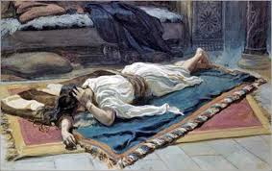

Slide 46
Acts 13
22 After removing Saul, he made David their king. God testified concerning him: ‘I have found David son of Jesse,

Slide 47
‘I have found David son of Jesse, a man after my own heart; he will do everything I want him to do.’

Slide 48
2 Corinthians 7
8 Even if I caused you sorrow by my letter, I do not regret it. Though I did regret it—I see that my letter hurt you, but only for a little while

Slide 49
9 yet now I am happy, not because you were made sorry, but because your sorrow led you to repentance.

Slide 50
For you became sorrowful as God intended and so were not harmed in any way by us.

Slide 51
10 Godly sorrow brings repentance that leads to salvation and leaves no regret, but worldly sorrow brings death.

Slide 52
11 See what this godly sorrow has produced in you

Slide 53
what earnestness, what eagerness to clear yourselves, what indignation, what alarm, what longing, what concern,

Slide 54
what readiness to see justice done. At every point you have proved yourselves to be innocent in this matter.

Slide 55
12 So even though I wrote to you, it was neither on account of the one who did the wrong nor on account of the injured party,

Slide 56
but rather that before God you could see for yourselves how devoted to us you are.

Slide 57
13 By all this we are encouraged.

Slide 58
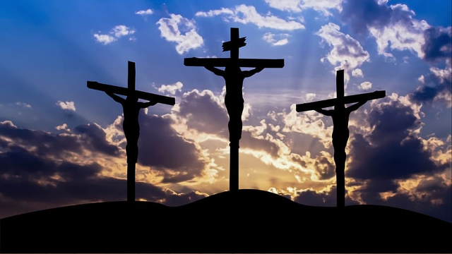

Slide 59
The apostle Paul described his own battles with sin: “What a wretched man I am! Who will rescue me from this body of death?”

Slide 60
Then he gives the answer: “Thanks be to God—through Jesus Christ our Lord!” (Romans 7:24–25).

Slide 61
Godly sorrow results from a heart-felt conviction that we have offended God by our sin. Such a burning conviction produces in our hearts a godly sorrow.

Slide 62
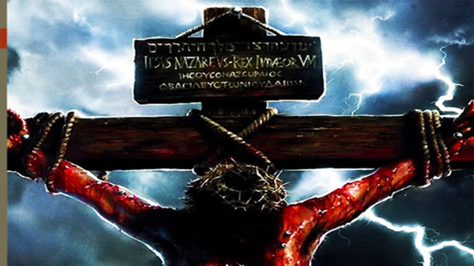

Slide 63
As we look upon Him who was pierced for our sins, we are deeply grieved in spirit.

Slide 64
And we resolve within our hearts that we will, with the help of God, “cease to do evil, and learn to do good” (Isaiah 1:16).

Slide 65
Luke 18
10 “Two men went up to the temple to pray, one a Pharisee and the other a tax collector.

Slide 66
11 The Pharisee stood by himself and prayed: ‘God, I thank you that I am not like other people

Slide 67
robbers, evildoers, adulterers—or even like this tax collector.

Slide 68
12 I fast twice a week and give a tenth of all I get.’

Slide 69
13 “But the tax collector stood at a distance. He would not even look up to heaven, but beat his breast and said, ‘God, have mercy on me, a sinner.’

Slide 70
14 “I tell you that this man, rather than the other, went home justified before God.

Slide 71
For all those who exalt themselves will be humbled, and those who humble themselves will be exalted.”

Slide 72


Slide 73


