Slide 1
The Glue

Slide 2

Sorrow
sorrow

Slide 3
GODLY SORROW:
A kind of wretchedness that can bring a repentant sinner to tears of GREIF.

Slide 4
There are two types of sorrow.
Worldly Sorrow
GODLY Sorrow

Slide 5
2 Corinthians 7
10 For godly sorrow produces repentance leading to salvation, not to be regretted;

Slide 6
but the sorrow of the world produces death.

Slide 7
11 See what this godly sorrow has produced in you

Slide 8
what earnestness, what eagerness to clear yourselves, what indignation, what alarm, what longing, what concern,

Slide 9
what readiness to see justice done. At every point you have proved yourselves to be innocent in this matter.

Slide 10
Godly sorrow results from a heart-felt conviction that we have offended God by our sin. Such a burning conviction produces in our hearts a godly sorrow.

Slide 11


Slide 12
Works Vs Good deeds

Slide 13
Works Spiritual
Good deeds fleshly

Slide 14
James 2
14 What does it profit, my brethren, if someone says he has faith but does not have works?

Slide 15
15 If a brother or sister is naked and destitute of daily food,

Slide 16
but you do not give them the things which are needed for the body, what does it profit?

Slide 17
16 and one of you says to them, “Depart in peace, be warmed and filled,”

Slide 18
17 Thus also faith by itself, if it does not have works, is dead.

Slide 19
18 But someone will say, “You have faith, and I have works.”

Slide 20
Show me your faith without your works, and I will show you my faith by my works.

Slide 21
19 You believe that there is one God. You do well. Even the demons believe—and tremble!

Slide 22
20 But do you want to know, O foolish man, that faith without works is dead?

Slide 23
21 Was not Abraham our father justified by works when he offered Isaac his son on the altar?

Slide 24
22 Do you see that faith was working together with his works, and by works faith was made perfect?

Slide 25
23 And the Scripture was fulfilled which says, “Abraham believed God,

Slide 26
and it was accounted to him for righteousness.” And he was called the friend of God.

Slide 27
24 You see then that a man is justified by works, and not by faith only.

Slide 28
26 For as the body without the spirit is dead, so faith without works is dead also.

Slide 29
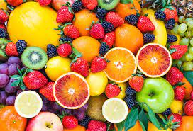
Faith Works Fruit

Slide 30
Romans 12
3 For I say, through the grace given unto me, to every man that is among you, not to think of himself more highly than he ought to think;

Slide 31
but to think soberly, according as God hath dealt to every man the measure of faith.

Slide 32
Hebrews 11
6 But without faith it is impossible to please him:

Slide 33
20 But do you want to know, O foolish man, that faith without works is dead?

Slide 34
Luke 13
6 He spake also this parable; A certain man had a fig tree planted in his vineyard; and he came and sought fruit thereon, and found none.

Slide 35
7 Then said he unto the dresser of his vineyard, Behold, these three years I come seeking fruit on this fig tree, and find none:

Slide 36
cut it down; why cumbereth it the ground?

Slide 37
8 And he answering said unto him, Lord, let it alone this year also, till I shall dig about it, and dung it:

Slide 38
9 And if it bear fruit, well: and if not, then after that thou shalt cut it down.

Slide 39
Putting off putting on

Slide 40
Colossians 3
2 Set your affection on things above, not on things on the earth.

Slide 41
3 For ye are dead, and your life is hid with Christ in God.

Slide 42
4 When Christ, who is our life, shall appear, then shall ye also appear with him in glory.

Slide 43
5 Therefore put to death your members which are on the earth: fornication, uncleanness, passion, evil desire, and covetousness, which is idolatry

Slide 44
6 Because of these things the wrath of God is coming upon the sons of disobedience

Slide 45
7 in which you yourselves once walked when you lived in them.

Slide 46
8 But now you yourselves are to put off all these: anger

Slide 47
wrath, malice, blasphemy, filthy language out of your mouth.

Slide 48
9 Do not lie to one another, since you have put off the old man with his deeds,

Slide 49
10 and have put on the new man who is renewed in knowledge according to the image of Him who created him,

Slide 50
11 where there is neither Greek nor Jew, circumcised nor uncircumcised, barbarian, Scythian, slave nor free,

Slide 51
but Christ is all and in all.

Slide 52
12 Therefore, as the elect of God, holy and beloved, put on

Slide 53
tender mercies, kindness, humility, meekness, longsuffering;

Slide 54
13 bearing with one another, and forgiving one another, if anyone has a complaint against another; even as Christ forgave you, so you also must do.

Slide 55
14 But above all these things put on love, which is the bond of perfection.

Slide 56
GODLY SORROW
FAITH IN ACTION
PRODUCING FRUIT OFF WITH THE OLD ON WITH THE NEW

Slide 57

Tender Mercies Kindness Humility Meekness longsuffering Forgivness

Slide 58
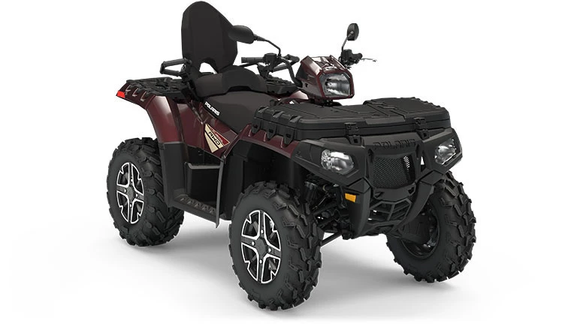

Slide 59
