Slide 1


1

Slide 2
Welcome to:
Dare to share
Evangelism equipping
Lesson 1 – GOD’S DESIGN FOR US

Slide 3
Question to explore
What does God expect of me since He created and designed me for a purpose?

Slide 4
Discuss
Give an example of something you purchased that did not work until you started over and read the owner’s manual and assembly instructions.

Slide 5
Discuss
What are some examples of brokenness you have seen or heard about this past week?

Slide 6


Slide 7
1. THERE IS A PERFECT
DESIGNER WITH A PERFECT PLAN
FOR YOUR LIFE.

Slide 8
Genesis 1:31
“God saw all that He had made, and it was very good."

Slide 9
Discuss
Give examples of
how you know your unique design and put that design into practice each day.

Slide 10
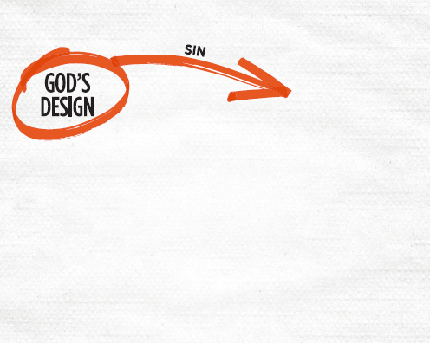

Slide 11
2. SIN IS THE CAUSE
OF BROKENNESS.

Slide 12
Everyone has Sinned
Romans 3:23a
“All have sinned and fall short of the
glory of God . . .”

Slide 13
Discuss
Describe a time when
you experienced frustration over trying
to do something
your way.

Slide 14
Discuss
What did you
do to resolve the frustration?

Slide 15
Sin Leads to Death –
Physically and Eternally
Romans 6:23a
“For the wages of sin is death . . .”

Slide 16
Reflect
How does this lesson challenge you to “return to God’s design for your life?”

Slide 17
Respond to the text
What does God expect of me since He created and designed me with a purpose? Part of the answer to that question is that once God has saved us and removed our brokenness, He involves us in helping broken people experience God’s love and life.

Slide 18
Apply
Write down the names
of four people in your life who have not come to know God and are in brokenness:

Slide 19
Apply
A family member
A friend
A neighbor or coworker
That one person who is far from God and we think would never come to faith in Christ

Slide 20
Apply
Begin praying
for them and for opportunities to
share God’s love
with them.

Slide 21
Apply
Practice reading
the 3 Circles booklet aloud at home to become comfortable using it as God provides opportunities to share His love with them.

