Slide 1
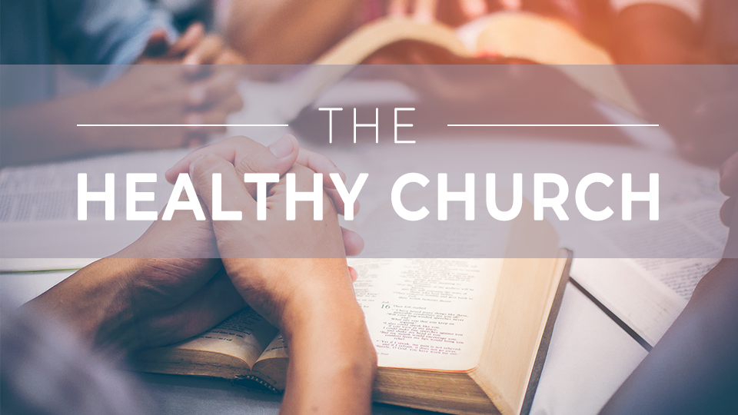

Slide 2
The
Healthy church
Session 4:
Church Membership

Slide 3
THINK ABOUT THIS…
Why is church membership important?

Slide 4
Discuss
Is church membership an outdated concept or is it still important today? Why?

Slide 5
1. CHURCH MEMBERSHIP DEMONSTRATES
OUR COMMITMENT TO ONE ANOTHER.

Slide 6
Philippians 2:1-4
“If, then, there is any encouragement in Christ, if any consolation of love, if any fellowship with the Spirit, if any affection and mercy, make my joy complete by thinking the same way, having the same love, united in spirit, intent on one purpose. →

Slide 7
Philippians 2:1-4
Do nothing out of selfish ambition or conceit, but in humility consider others as more important than yourselves. Everyone should look not to his own interests, but rather to the interests of others.”

Slide 8
Philippians 2:1-4
Mutual love (v. 2)

Slide 9
Philippians 2:1-4
Mutual love (v. 2)
United in spirit and purpose (v. 2)

Slide 10
Philippians 2:1-4
Mutual love (v. 2)
United in spirit and purpose (v. 2)
Serve with humility (v. 3)

Slide 11
Philippians 2:1-4
Mutual love (v. 2)
United in spirit and purpose (v. 2)
Serve with humility (v. 3)
Look to the interests of others (v. 4).

Slide 12
Discuss
Look back at Philippians
2:1-2. When has Christ shown you encouragement, consolation, affection, or mercy through the ministry of a local church?

Slide 13
Discuss
What does it look like to “serve the Lord with gladness” (Psalm 100:2)? How can sitting on the sidelines of a church keep someone from experiencing the fullness of joy God intends?

Slide 14
Discuss
What does looking to
the interests of others look like in your personal life, family, small group, or church right now?

Slide 15
2. CHURCH MEMBERSHIP
GIVES US ACCOUNTABILITY TO ASSEMBLE REGULARLY WITH
ONE ANOTHER.

Slide 16
Hebrews 10:24-25
“And let us consider one another in order to provoke love and good works, not neglecting to gather together, as some are in the habit of doing, but encouraging each other, and all the more as you see the day approaching.”

Slide 17
Discuss
What are some things in
our current culture and pace of life that make it challenging to maintain
our commitment to a local church body?

Slide 18
Discuss
What vital aspects
of life in Christ do we miss out on without Christian community?

Slide 19
Discuss
When has someone
encouraged you in your faith as you struggled? How does being a part of a church family help us see and respond to other people’s needs?

Slide 20
3. CHURCH MEMBERSHIP
ALLOWS US TO BE THE BODY OF CHRIST TO ONE ANOTHER.

Slide 21
1 Corinthians 12:24b-27
“Instead, God has put the body together, giving greater honor to the less honorable, so that there would be no division in the body, but that the members would have the same concern for each other. →

Slide 22
1 Corinthians 12:24B-27
So if one member suffers, all the members suffer with it; if one member is honored, all the members rejoice with it. Now you are the body of Christ, and individual members of it.”

Slide 23
Discuss
Why might jealousy arise where spiritual gifts are concerned? Why do we esteem some gifts as more valuable? How does the Bible refute this?

Slide 24
Discuss
Think of some roles
in the church that are often undervalued. How do these roles fulfill the mission of the church just as much as more “glamorous” roles?

Slide 25
Discuss
How could you dedicate the gifts God has given you back to His service in a real, tangible way. What would need to shift for you to connect to serving His church in a meaningful way?

Slide 26
GOSPEL FOCUS
Torn Veil, Open Door: Christ, Community, and the Call of the Local Church.
At Jesus’s death on the cross for our sins, the temple veil was torn in two from top to bottom, removing the separation that stood between God and His people. →

Slide 27
GOSPEL FOCUS
Today, we can come to Him in confidence not through our own merit but by the grace and mercy of Christ. The life-giving, life-changing gospel is not meant to be hidden away. Instead, God gave us the local church so we could gather to worship Him and to invite others into fellowship with God. →

Slide 28
GOSPEL FOCUS
The local church is better with all its members. When you commit yourself to a local church, you bring your worship, talents, service, and gifts into the greater purpose of making Christ known in your community and beyond.

Slide 29
Reflect
Why do you think it is important for people to be members of the church before serving in positions of teaching or leading? What does church membership imply about shared values?

Slide 30
Reflect
What makes it hard
to maintain regular church attendance? Does your family have a rhythm or commitment that prioritizes gathering with God’s people each week?
If not, how could you establish this?

Slide 31
Reflect
How does today’s
teaching help you see the purpose of spiritual gifts in the life of the individual and the church?

Slide 32
Respond
A healthy church is one where a local group of believers assemble regularly for the purpose of worship, study, fellowship, and service. They use their gifts in service to one another. →

Slide 33
Respond
Church membership is
the starting point of connecting with a local body. Is there a way you or your family need
to connect with this body of believers in a new or
deeper way?

Slide 34
Apply
Have you prioritized church membership and regular church attendance? Is there something in your schedule that needs to shift to make space for a deeper connection with God’s people?

Slide 35
Apply
How might the church benefit from the specific ways God has gifted you?

