Slide 1
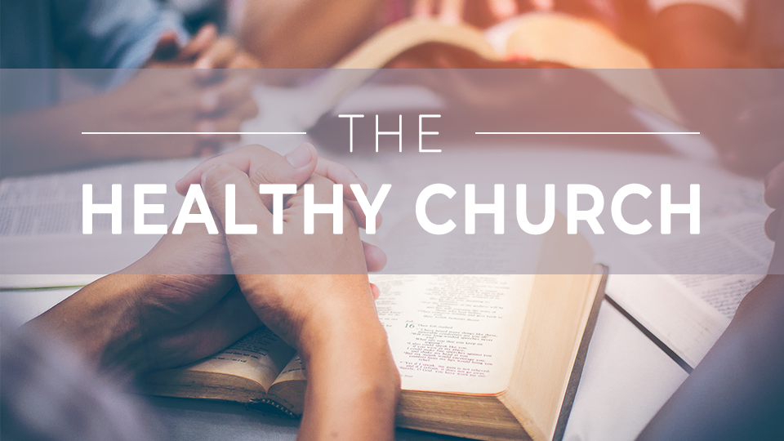

Slide 2
The
Healthy church
Session 6:
Preaching and Teaching

Slide 3
THINK ABOUT THIS…
What role does the Bible have in
your everyday life? How could you grow in personal study of God’s Word this week?

Slide 4
Discuss
What role does biblical
teaching play in your everyday life? Could you explain to someone what’s important to you about learning Scripture?

Slide 5
1. CHRIST AND HIS WORD SHOULD BE CENTRAL IN OUR HEARTS.

Slide 6
Acts 2:36-37
“Therefore let all the house of Israel know with certainty that God has made this Jesus, whom you crucified, both Lord and Messiah.” When they heard this, they were pierced to the heart and said to Peter and the rest of the apostles, “Brothers, what should we do?”

Slide 7
Discuss
What can we learn from
the fact that Peter’s primary means of proclaiming Jesus was pointing to the promises found in God’s Word
about Him?

Slide 8
Discuss
Why is it important that
we hear the Word of God taught and that we study
it personally?

Slide 9
Discuss
How has your testimony
been impacted by faithful teaching and preaching?

Slide 10
2. GOD’S WORD SHOULD BE CENTRAL IN OUR PULPIT.

Slide 11
Acts 17:1-4
“After they passed through Amphipolis and Apollonia, they came to Thessalonica, where there was a Jewish synagogue. →

Slide 12
Acts 17:1-4
As usual, Paul went into the synagogue, and on three Sabbath days reasoned with them from the Scriptures, explaining and proving that it was necessary for the Messiah to suffer and rise from the dead: “This Jesus I am proclaiming to you is the Messiah.” →

Slide 13
Acts 17:1-4
Some of them were persuaded and joined Paul and Silas, including a large number of God-fearing Greeks, as well as a number of the leading women.”

Slide 14
Discuss
Where might you
need to be challenged regarding your value of the preached Word?

Slide 15
Discuss
How does expository preaching in particular help the church grow in discipleship?

Slide 16
Discuss
How can we position ourselves to receive faithful teaching of the Word?

Slide 17
3. GOD’S WORD SHOULD BE CENTRAL IN OUR STUDY.

Slide 18
Acts 17:10-12
“As soon as it was night, the brothers and sisters sent Paul and Silas away to Berea. Upon arrival, they went into the synagogue of the Jews. →

Slide 19
Acts 17:10-12
The people here were of more noble character than those in Thessalonica, since they received the word with eagerness and examined the Scriptures daily to see if these things were so. Consequently, many of them believed, including a number of the prominent Greek women as well as men.”

Slide 20
Acts 18:24-26
“Now a Jew named Apollos, a native Alexandrian, an eloquent man who was competent in the use of the Scriptures, arrived in Ephesus. He had been instructed in the way of the Lord; and being fervent in spirit, he was speaking and teaching accurately about Jesus, although he knew only John’s baptism. →

Slide 21
Acts 18:24-26
He began to speak boldly in the synagogue. After Priscilla and Aquila heard him, they took him aside and explained the way of God to him more accurately.”

Slide 22
Discuss
How did the Berean
Jews demonstrate a commitment to
Scripture?

Slide 23
Discuss
Why do you think it
was important that Aquilla and Priscilla addressed Apollos’s incorrect teaching?

Slide 24
Discuss
Is your preparation and participation in your Connect Group based on God’s Word over human opinion? How might we grow in this?

Slide 25
GOSPEL FOCUS
Jesus came so that we might be saved.
In Romans 10:17 we read that “faith comes by hearing, and hearing by the Word of God” (NKJV). When Scripture is central in our hearts, central in our pulpit, and central in our groups, then Christ is proclaimed and people come to know Him. →

Slide 26
GOSPEL FOCUS
For believers, the ongoing reception of God’s Word in our personal Bible Study, in the weekly sermon, and in our small group helps us to grow in biblical wisdom and build our lives on the foundation of Christ’s enduring Word (Matthew 7:24).

Slide 27
Reflect
What does your personal Bible Study practice look like? Is there an opportunity to reengage in God’s Word in a fresh way this week?

Slide 28
Reflect
How do you approach listening to the sermon?
Do you come to worship expecting to hear a Word
from God? Why or
why not?

Slide 29
Reflect
How can you seek to
grow as a student of those who preach and teach in
our church?

Slide 30
Respond
The early church grew when Scripture was preached faithfully in both large and small group settings. The same is true today. The church grows when the Bible is central to our teaching and preaching. How can you make the Bible central in your life this week?

Slide 31
Apply
In the late Eugene Peterson’s Eat This Book, he encourages the body of believers to feast daily on God’s Word. What would need to change in your day-to-day and Sunday experience to approach God’s Word as a feast to be enjoyed?

