Slide 1
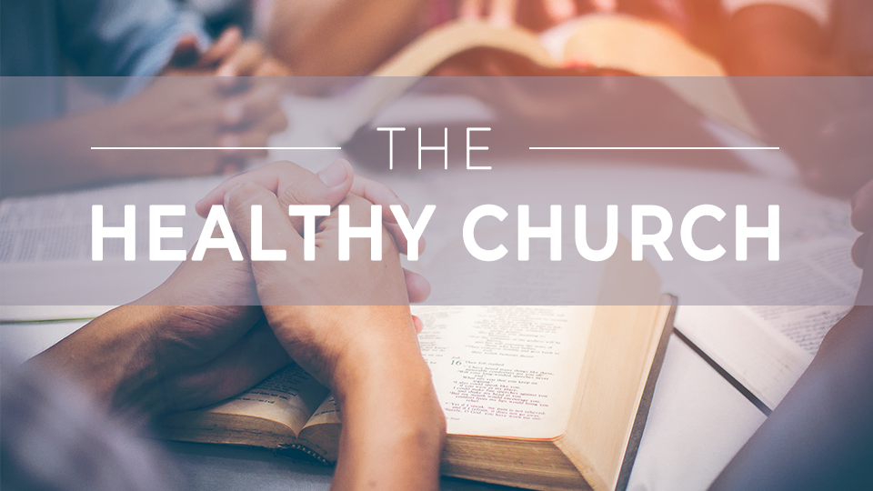

Slide 2
The
Healthy church
Session 9:
Fellowship

Slide 3
THINK ABOUT THIS…
What are some incorrect ways you’ve thought about church fellowship?
Look for ways today’s lesson might challenge and expand your perspective.

Slide 4
Discuss
Do you look forward to church fellowship, or do you find yourself shrinking back from self-disclosure and community? What does authentic fellowship look like, and what are some barriers in our world that make it difficult to achieve?

Slide 5
1. IN HEALTHY CHURCHES, MEMBERS LOVE ONE ANOTHER.

Slide 6
John 13:34-35
“I give you a new command:
Love one another. Just as I have loved you, you are also to love one another. By this everyone will know that you are my disciples, if you love one another.”

Slide 7
Discuss
Why is the word agape
fitting to describe not only God’s love for us but also
the way we should love
one another?

Slide 8
Discuss
How does a Western
view of the world impact the way we see church community?

Slide 9
Discuss
What can keep us from experiencing the kind of loving church community we just read about?

Slide 10
2. IN HEALTHY
CHURCHES, MEMBERS SPUR
ONE ANOTHER ON.

Slide 11
Hebrews 10:24-25
“And let us consider one another in order to provoke love and good works, not neglecting to gather together, as some are in the habit of doing, but encouraging each other, and all the more as you see the day approaching.”

Slide 12
Discuss
Why is church community such an important part of discipleship?

Slide 13
Discuss
How are you tempted to neglect gathering together in this way?

Slide 14
Discuss
Can you recall a time someone nudged you toward righteousness and it made a positive impact in your walk with Christ? How have you done this for others?

Slide 15
3. IN HEALTHY
CHURCHES MEMBERS SERVE ONE ANOTHER GLADLY.

Slide 16
Colossians 3:12-17
“Therefore, as God’s chosen ones, holy and dearly loved, put on compassion, kindness, humility, gentleness, and patience, bearing with one another and forgiving one another if anyone has a grievance against another. →

Slide 17
Colossians 3:12-17
Just as the Lord has forgiven you, so you are also to forgive. Above all, put on love, which is the perfect bond of unity. And let the peace of Christ, to which you were also called in one body, rule your hearts. And be thankful. →

Slide 18
Colossians 3:12-17
Let the word of Christ dwell richly among you, in all wisdom teaching and admonishing one another through psalms, hymns, and spiritual songs, singing to God with gratitude in your hearts. And whatever you do, in word or in deed, do everything in the name of the Lord Jesus, giving thanks to God the Father through him.”

Slide 19
Discuss
How can joining a
body of believers feel
like an awkward middle school moment?

Slide 20
Discuss
How would you respond
to someone who said, “I don’t want to come to church because I won’t know how to act or what to do, say, or wear”?

Slide 21
Discuss
How does Colossians
3:17 challenge the way you think about your responsibility in deepening your own
sense of fellowship and community?

Slide 22
GOSPEL FOCUS
Love sacrificially, endure together.
The church is called to endure and live sacrificially with one another as Christ has done for us. Many are deterred from joining a church because of legitimate hurt or fear. Christ endured more than will ever be asked of us to save His people and bring them to Him forever. →

Slide 23
GOSPEL FOCUS
This doesn’t mean our hurts or fears don’t matter, but it does mean God calls us to work through these things in the context of a local body that will love us as Christ loves us and point us back to the gospel at every point.

Slide 24
Reflect
Where have you diminished the importance of fellowship with other believers?

Slide 25
Reflect
How have you experienced the spurring on that takes place in Christian community?

Slide 26
Respond
In John 13:34-35 Jesus essentially said the world can judge our relationship with Christ based on our relationships with others. How would the world judge you by this standard?

Slide 27
Respond
Who is God calling you to
stir up or spur on toward godliness this week?

Slide 28
Respond
How can you live sacrificially
for the sake of others in
the church this week?

Slide 29
Apply
Joining a community of believers can be difficult because it is made up of imperfect people just like you. But community is worth the pursuit.

Slide 30
Apply
The Bible makes clear that we cannot live fully as God intends in isolation. What further step do you need to take toward fellowship in the church this week?

