Slide 1
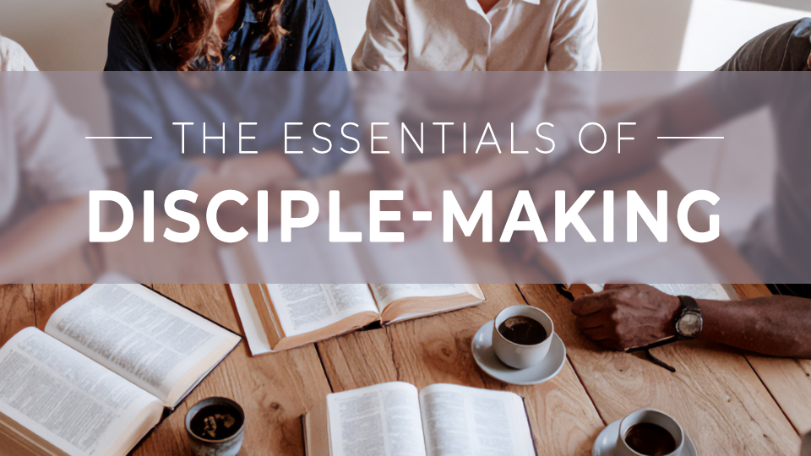

Slide 2
The essentials of
Disciple-making
Session 2:
Marching Orders

Slide 3
THINK ABOUT THIS…
What was Christ’s final command to His disciples, and how does it apply to the church today?

Slide 4
Discuss
Have you ever thought of the Great Commission primarily as a verse for people called to the mission field? How could a narrow view of Christ’s command keep us from experiencing the fullness of God’s plan for us?

Slide 5
1. Jesus is our authority.

Slide 6
Matthew 28:16-18
“The eleven disciples traveled to Galilee, to the mountain where Jesus had directed them. When they saw him, they worshiped, but some doubted. Jesus came near and said to them, “All authority has been given to me in heaven and on earth.”

Slide 7
Discuss
What is a difficult
skill you’ve learned throughout your life? What kept you going, despite the difficulty?

Slide 8
Discuss
Can you think of an encounter you have had with Jesus that prompted you to worship?

Slide 9
Discuss
How can we respond
to Christ’s authority in our lives today?

Slide 10
2. Making disciples is our mission.

Slide 11
Matthew 28:19-20a
“Go, therefore, and make disciples of all nations, baptizing them in the name of the Father and of the Son and of the Holy Spirit, teaching them to observe everything I have commanded you.”

Slide 12
Discuss
The disciples likely
didn’t feel equipped for the task they were given and neither do we. What is our ultimate hope in carrying out this call of Christ?

Slide 13
Discuss
How does an understanding of the verb usage in Matthew 28:19-20a impact the way you understand your role in fulfilling the Great Commission?

Slide 14
Discuss
What would look different about your church experience if you saw daily ministry in the local church as part of fulfilling the Great Commission?

Slide 15
3. Eternity is our promise.

Slide 16
Matthew 28:20b
“And behold, I am with you always, to the end of the age.”

Slide 17
Discuss
What does it mean
to “behold” Jesus in
daily life?

Slide 18
Discuss
What things get in the
way of seeing His activity in your day-to-day life?

Slide 19
Discuss
How does knowing
Jesus is with you help you overcome the fear you might have in telling others about Him?

Slide 20
GOSPEL FOCUS
God’s people share Jesus with others.
God could have chosen any way to communicate the good news of Jesus. At the birth of Jesus, He used angels. At the birth of the church, He used His people. The Great Commission isn’t busy work for the church—it is the work of the church. →

Slide 21
GOSPEL FOCUS
Jesus heals; we serve and disciple.
The good news of Jesus is that God loved us so much He sent His Son to die on the cross for our sins, be resurrected, and He invites us into an eternal relationship with Him. Those who have experienced God’s love and forgiveness will desire to share it with others. →

Slide 22
GOSPEL FOCUS
Jesus heals; we serve and disciple.
The Great Commission is our marching orders, and Jesus says He will go with us as we reach people for Him.

Slide 23
Reflect
What excites you about participating in the Great Commission?

Slide 24
Reflect
What frightens or holds you back from telling others about Jesus?

Slide 25
Reflect
How can you trust
Jesus to be with you,
no matter your doubts or other challenges?

Slide 26
Respond
How does acknowledging Jesus’s authority and reflecting on His constant presence help us overcome the fear we might have about sharing our faith?

Slide 27
Apply
How has your view on the Great Commission changed through today’s study? How does Jesus want you to participate in His command to make disciples?

