Slide 1
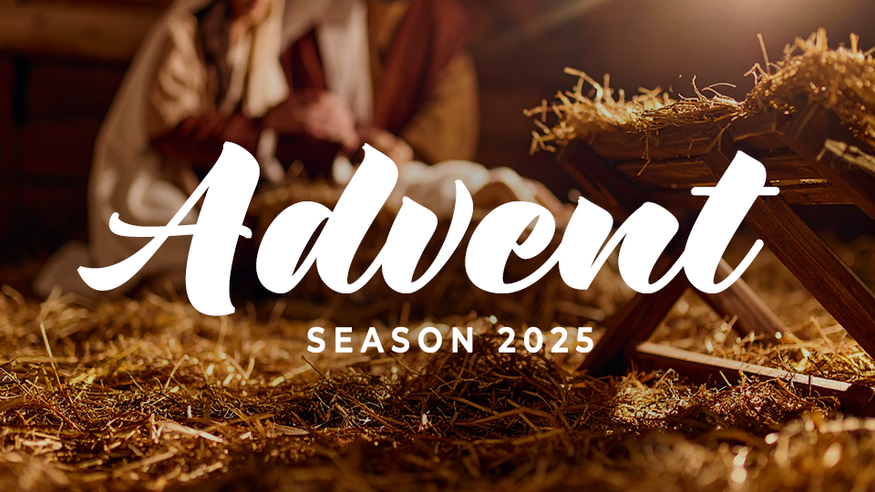

Slide 2
Advent
Season 2025
Session one: hope

Slide 3
HOPE
Hope is confidence that God works in our lives. It’s the trust that, even in difficult circumstances, God’s plans are good.

Slide 4
THINK ABOUT THIS…
Consider where you are tempted to hope in lesser things. How does reading Jesus’s fulfillment of prophecies bring you hope?

Slide 5
Discuss
Conservatively speaking, Jesus fulfilled more than 300 Old Testament prophesies through His birth, life, death, and resurrection. How can reflecting on God’s faithfulness to keep His promises give us hope as we enter this season of advent?

Slide 6
1. We have hope because God keeps His promises.

Slide 7
Jeremiah 33:14-16
“Look, the days are coming”—
this is the LORD’s declaration—
“when I will fulfill the good promise
that I have spoken
concerning the house of Israel
and the house of Judah.
→

Slide 8
Jeremiah 33:14-16
In those days and at that time
I will cause a Righteous Branch
to sprout up for David,
and he will administer justice
and righteousness in the land.
→

Slide 9
Jeremiah 33:14-16
In those days Judah will be saved,
and Jerusalem will dwell securely,
and this is what she will be named:
The LORD Is Our Righteousness.”

Slide 10
Discuss
Do you wait for
Christmas with hopeful expectation? If so, how do you maintain that expectancy? If not, what gets in the way of experiencing the hope of Advent?

Slide 11
Discuss
How did God demonstrate His faithfulness to Judah, even while telling them they would go into exile? How can that be a comfort to us in a season of waiting?

Slide 12
Discuss
Reflect on 2
Corinthians 1:20. How are
all of God’s promises answered in Christ?

Slide 13
2. We can have hope because Jesus reigns now and forever.

Slide 14
Isaiah 9:2,6-7
² The people walking in darkness
have seen a great light;
a light has dawned
on those living in the land of darkness.
→

Slide 15
Isaiah 9:2,6-7
⁶ For a child will be born for us,
a son will be given to us,
and the government will be on his shoulders.
→

Slide 16
Isaiah 9:2,6-7
He will be named
Wonderful Counselor, Mighty God,
Eternal Father, Prince of Peace.
The dominion will be vast,
and its prosperity will never end.
→

Slide 17
Isaiah 9:2,6-7
He will reign on the throne of David
and over his kingdom,
to establish and sustain it
with justice and righteousness from now on and forever.
→

Slide 18
Isaiah 9:2,6-7
The zeal of the LORD of Armies will accomplish this.

Slide 19
Discuss
In what ways were the Israelites “walking in darkness”? How can we walk in the light of this Advent season?

Slide 20
Discuss
Which name for the
Jesus (Wonderful counselor, Mighty God, Eternal Father, Prince of Peace) resonates most with you right now? Why?

Slide 21
Discuss
God kept promises
through the prophet Isaiah, fulfilled 700 years later in Jesus. How does knowing God kept His promises to Israel encourage you this Advent season?

Slide 22
3. We can have hope as we wait on the Lord.

Slide 23
Psalm 130:5-8
“I wait for the LORD; I wait
and put my hope in his word.
I wait for the Lord
more than watchmen for the morning—
more than watchmen for the morning.
→

Slide 24
Psalm 130:5-8
Israel, put your hope in the LORD.
For there is faithful love with the LORD,
and with him is redemption in abundance.
And he will redeem Israel
from all its iniquities.”

Slide 25
Discuss
What is the hardest
part for you (or your kids) about waiting for Christmas?

Slide 26
Discuss
Can you relate to the picture of the watchman on the wall waiting for dawn? Have you ever “strained your eyes” waiting to see God’s deliverance? How did that season ultimately help your faith grow?

Slide 27
Discuss
This Psalm ends by
saying God will “redeem Israel from all its iniquities.” How does experiencing God’s forgiveness help you find hope in difficult seasons?

Slide 28
GOSPEL FOCUS
Christ’s birth brings salvation.
Advent is the four-week season of anticipation leading to the celebration of Christ’s birth. Christians all over the world mark these four Sundays as a time of expectant hope in the arrival of the savior. →

Slide 29
GOSPEL FOCUS
Christ’s birth brings salvation.
When Isaiah prophesied about Christ’s birth, and the salvation that would be available to all people he said, “the zeal of the LORD will accomplish this” (Isaiah 9:7). Salvation is not made available to people through our own effort or perseverance. →

Slide 30
GOSPEL FOCUS
Christ’s birth brings salvation.
Salvation is made available because Jesus accomplished it on the cross. When He died for our sins, He made a way for us to experience forgiveness, new life, and eternal hope in Him. When we say “yes” to Jesus, we are trusting Him to accomplish salvation for us.

Slide 31
Reflect
How do today’s texts help
you think about waiting with expectant hope?

Slide 32
Reflect
Where do you feel particularly in need of hope this year?

Slide 33
Respond
How could you
intentionally watch for the Lord’s activity during this Advent season?

Slide 34
Apply
Is there a situation in
your life that feels unresolved? What would it look like to embrace hope and expectation during this season of waiting?

