Slide 1
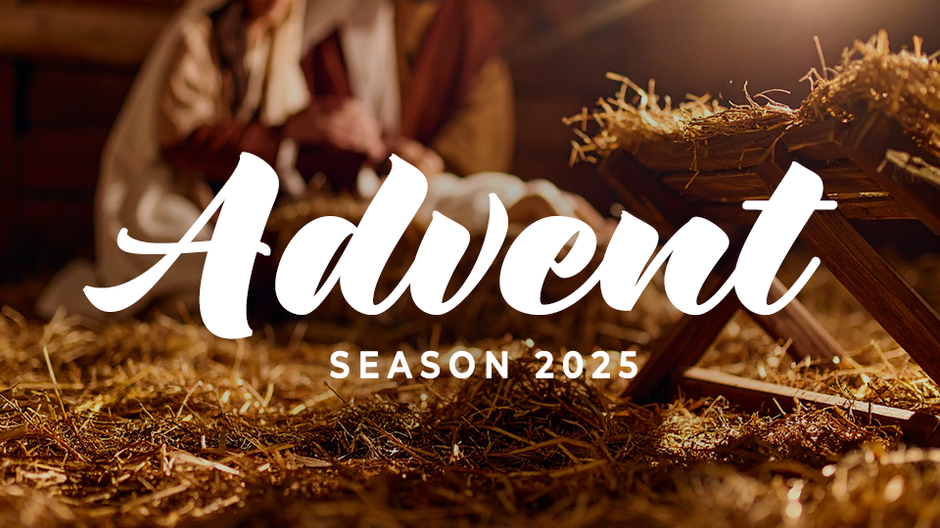

Slide 2
Advent
Season 2025
Session one: peace

Slide 3
PEACE
Peace is a deep sense of wholeness from knowing God’s presence in our lives and experiencing reconciliation with Him and others.

Slide 4
THINK ABOUT THIS…
How does Jesus’s birth—in the middle of a Roman occupation, with Mary and Joseph far from home, and in humble circumstances—point you toward the kind of peace God offers?

Slide 5
Discuss
How does Jesus’s birth - in
the middle of a Roman occupation, with Mary and Joseph far from home, and in humble circumstances - point you toward the kind of peace God offers?

Slide 6
1. We experience peace when we look to Jesus.

Slide 7
Micah 5:1-4
“Now, daughter who is under attack,
you slash yourself in grief;
a siege is set against us!
They are striking the judge of Israel
on the cheek with a rod.
→

Slide 8
Micah 5:1-4
Bethlehem Ephrathah,
you are small among the clans of Judah;
one will come from you
to be ruler over Israel for me.
His origin is from antiquity,
from ancient times.
→

Slide 9
Micah 5:1-4
Therefore, Israel will be abandoned until the time when she who is in labor has given birth; then the rest of the ruler’s brothers will return to the people of Israel.
→

Slide 10
Micah 5:1-4
He will stand and shepherd them
in the strength of the Lord, in the
majestic name of the Lord his God.
They will live securely, for then his greatness will extend to the ends
of the earth.
→

Slide 11
Discuss
What about the
Christmas season makes
it difficult for you to experience peace?

Slide 12
Discuss
Can you think of a time
when you sensed God’s peace even though difficult circumstances had not
yet changed?

Slide 13
Discuss
What needs to change to make space to look to Jesus and experience His peace this advent season?

Slide 14
2. We experience peace because of the incarnation.

Slide 15
Luke 2:1-7
In those days a decree went out from Caesar Augustus that the whole empire should be registered. This first registration took place while Quirinius was governing Syria. So everyone went to be registered, each to his own town. →

Slide 16
Luke 2:1-7
Joseph also went up from the town of Nazareth in Galilee, to Judea, to the city of David, which is called Bethlehem, because he was of the house and family line of David, to be registered along with Mary, who was engaged to him and was pregnant. →

Slide 17
Luke 2:1-7
While they were there, the time came for her to give birth. Then she gave birth to her firstborn son, and she wrapped him tightly in cloth and laid him in a manger, because there was no guest room available for them.

Slide 18
Discuss
Have you ever had a
boss who was hard to follow? How did it negatively impact
your job?

Slide 19
Discuss
How does Joseph and Mary’s obedience both to Caesar Augustus and to God encourage you?

Slide 20
Discuss
Jesus was born in
less-than-ideal circumstances. How does the story of His humble birth give you peace in your current moments
of trouble?

Slide 21
3. We experience peace when we anticipate eternity with Jesus.

Slide 22
Romans 5:1-8
“Therefore, since we have been justified by faith, we have peace with God through our Lord Jesus Christ. We have also obtained access through him by faith into this grace in which we stand, and we boast in the hope of the glory of God. →

Slide 23
Romans 5:1-8
“And not only that, but we also boast in our afflictions, because we know that affliction produces endurance, endurance produces proven character, and proven character produces hope.
→

Slide 24
Romans 5:1-8
This hope will not disappoint us,
because God’s love has been poured out in our hearts through the Holy Spirit who was given to us.
→

Slide 25
Romans 5:1-8
For while we were still helpless, at the right time, Christ died for the ungodly. For rarely will someone die for a just person—though for a good person perhaps someone might even dare to die.
→

Slide 26
Romans 5:1-8
But God proves his own love for us in that while we were still sinners, Christ died for us.”

Slide 27
Discuss
Why must the birth of Christ be viewed in light
of the death and resurrection of Christ?

Slide 28
Discuss
How would you describe
your sense of peace before knowing Jesus and after?

Slide 29
Discuss
What is an area in
life where you need to experience Christ’s
peace today?

Slide 30
GOSPEL FOCUS
Christmas requires the cross.
The Bible says we are all sinners in need of forgiveness and reconciliation with God. Thankfully, that is not something we achieve on our own, rather something that Christ accomplished for us on the cross and in His resurrection.→

Slide 31
GOSPEL FOCUS
Christmas requires the cross.
We cannot truly have Christmas without the cross. If you have celebrated Jesus’s birth, but never received Him as your Savior, perhaps it’s time to ask someone to help you take the next steps of faith.

Slide 32
GOSPEL FOCUS
Christ’s birth brings salvation.
When Isaiah prophesied about Christ’s birth, and the salvation that would be available to all people he said, “the zeal of the LORD will accomplish this” (Isaiah 9:7). Salvation is not made available to people through our own effort or perseverance. →

Slide 33
Reflect
Why is it significant
that God worked through a wicked ruler to get Joseph, Mary, and Jesus to Bethlehem to fulfill Old Testament prophesy? What does that
tell us is possible for
our lives?

Slide 34
Reflect
How do the humble surroundings of Jesus’s birth demonstrate
God’s love?

Slide 35
Respond
Consider Christmas
through the lens of Easter. How can reflecting on the cross give us peace this Christmas?

Slide 36
Apply
How might you share the gospel by telling someone else about the peace available in Christ? Ask God to give you an opportunity to share Jesus with someone this Christmas.

