Slide 1
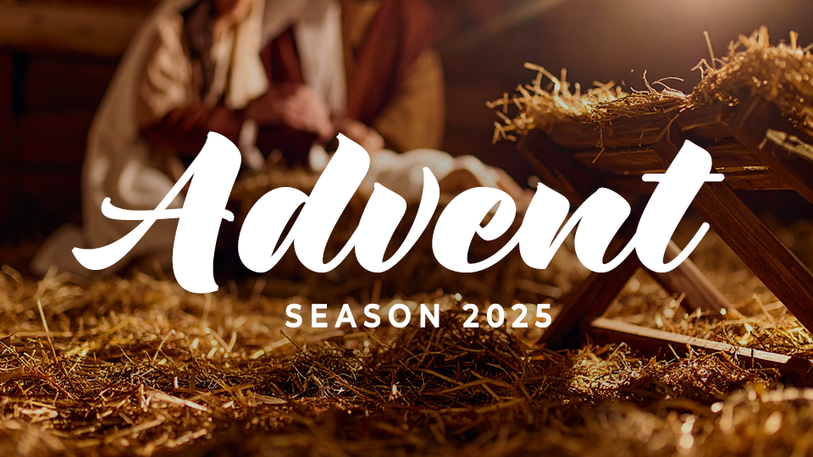

Slide 2
Advent
Season 2025
Session one: Joy

Slide 3
JOY
Joy is abundant gladness rooted in the good news of Jesus’s coming.

Slide 4
THINK ABOUT THIS…
Consider your experience of joy. What specific promises of God provide joy to those who are in Christ?

Slide 5
Discuss
What threatens to steal your joy this Christmas? What helps joy in Christ to grow?

Slide 6
1. Joy comes because of Jesus’s arrival.

Slide 7
Isaiah 35:1-10
The wilderness and the dry land will
be glad; the desert will rejoice and blossom like a wildflower. It will blossom abundantly and will also rejoice with joy and singing. The glory of Lebanon will
be given to it, the splendor of
Carmel and Sharon.→

Slide 8
Isaiah 35:1-10
They will see the glory of the Lord, the splendor of our God. Strengthen the weak hands, steady the shaking knees!
Say to the cowardly: “Be strong; do not fear! Here is your God; vengeance is coming. God’s retribution is coming; he will save you.” →

Slide 9
Isaiah 35:1-10
Then the eyes of the blind will be opened,
and the ears of the deaf unstopped. Then the lame will leap like a deer, and the tongue of the mute will sing for joy,
for water will gush in the wilderness,
and streams in the desert; →

Slide 10
Isaiah 35:1-10
the parched ground will become
a pool, and the thirsty land, springs. In the haunt of jackals, in their lairs, there will be grass, reeds, and papyrus. A road will be there and a way; it will be
called the Holy Way.
→

Slide 11
Isaiah 35:1-10
The unclean will not travel on it,
but it will be for the one who walks the path. Fools will not wander on it.
There will be no lion there, and no vicious beast will go up on it;
→

Slide 12
Isaiah 35:1-10
they will not be found there.
But the redeemed will walk on it, and the ransomed of the Lord will return and come to Zion with singing, crowned with unending joy. Joy and gladness will overtake them, and sorrow and
sighing will flee.

Slide 13
Discuss
Have you ever had
trouble traveling that made you wonder if the destination was worth the journey?

Slide 14
Discuss
How might the Israelites’ journey back to Judah have felt like a celebration? What perspective would they need to stay motivated for the
long journey?

Slide 15
Discuss
How does our final destination of being with Christ make this world’s pain and difficulty bearable? How can we have joy in the journey?

Slide 16
2. Joy often arrives unexpectedly and humbly.

Slide 17
Luke 2:8-20
In the same region, shepherds were
staying out in the fields and keeping
watch at night over their flock. Then an angel of the Lord stood before them, and the glory of the Lord shone around
them, and they were terrified. →

Slide 18
Luke 2:8-20
. But the angel said to them, “Don’t be afraid, for look, I proclaim to you good news of great joy that will be for all the people: Today in the city of David a Savior was born for you, who is the Messiah, the Lord.
→

Slide 19
Luke 2:8-20
This will be the sign for you: You will
find a baby wrapped tightly in cloth and lying in a manger.” Suddenly there was a multitude of the heavenly host with the angel, praising God and saying: →

Slide 20
Luke 2:8-20
“Glory to God in the highest heaven, and
peace on earth to people he favors!”
→

Slide 21
Luke 2:8-20
When the angels had left them and returned to heaven, the shepherds said to one another, “Let’s go straight to Bethlehem and see what has happened, which the Lord has made known to us.”

Slide 22
Discuss
What surprises you
more about the Christmas story—the humble place of Christ’s birth, or the humble nature of those who first received the good news?

Slide 23
Discuss
How can joy be
something we chase
at Christmas but
never find?

Slide 24
Discuss
What does it look like
to make haste to the manger? How can other things get in the way?

Slide 25
3. Joy is the natural response of encountering Jesus.

Slide 26
Romans 10:14-15
“How, then, can they call on him
they have not believed in? And how can they believe without hearing about him? And how can they hear without a preacher? And how can they preach unless they are sent? →

Slide 27
Romans 10:14-15
As it is written: How beautiful are the feet of those who bring good news.”

Slide 28
Discuss
Why is the
Christmas message necessarily tied to the Great Commission?

Slide 29
Discuss
How is sharing Jesus
tied to joy in Him?

Slide 30
Discuss
What is one way you
could be more intentional this Christmas about sharing the joy of Jesus with others?

Slide 31
GOSPEL FOCUS
Jesus’ birth brings joy & salvation
As the angels declared, Jesus’s birth is “good news, of great joy, for all the people.” That includes you. When we place our faith in Christ, we accept not only His birth, but His death and resurrection, paying for our sins and making a way for us to be reconciled to God.→

Slide 32
GOSPEL FOCUS
Jesus’ birth brings joy & salvation
If you have never made a decision to follow Jesus, talk to someone about where to begin
in this journey.

Slide 33
Reflect
How do you think Isaiah’s words encouraged the people even though most of them wouldn’t live long enough to see their return from captivity in Babylon? How can we maintain joy in long seasons of waiting?

Slide 34
Reflect
Why were the
shepherds, though unlikely, but perfect
people to first hear
about the birth
of Jesus?

Slide 35
Respond
Why can we not
separate the Christmas
story from the Great Commission? How will our celebration fall short
if we do?

Slide 36
Apply
What needs to change
in your celebration of Christmas to seek joy
in Christ alone?

