Slide 1
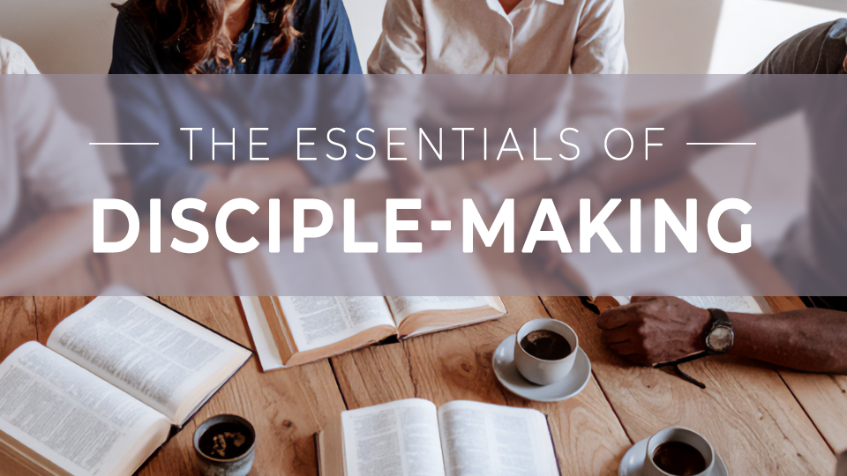

Slide 2
The essentials of
Disciple-making
Session 6:
Ten Qualifications of a
Disciple-Maker

Slide 3
THINK ABOUT THIS…
What qualities of a disciple maker are present in my life today, and what is lacking? How can I ask God to help me grow in those ways?

Slide 4
Discuss
Which is harder for you—growing in the depth of your walk with Christ, or growing in the authenticity and vulnerability of your relationship with others? What would growth in one or both of those areas look like for you?

Slide 5
1. The starting point of disciple making is our relationship with God and His Word.

Slide 6
2 Corinthians 5:14-15
For the love of Christ compels us, since we have reached this conclusion, that one died for all, and therefore all died. And he died for all so that those who live should no longer live for themselves, but for the one who died for them and was raised.

Slide 7
Discuss
Like preparing to climb a mountain, how does our personal training as students of God’s Word impact our ability to live as disciple makers?

Slide 8
Discuss
Think of a time you
have witnessed or heard about church leaders discrediting themselves for ministry because of a moral failure. How did it impact your faith? →

Slide 9
Discuss
Why is the personal walk of a disciple maker so important?

Slide 10
Discuss
How ready would you
be to share your testimony and the plan of salvation spontaneously? What could you do this week to better prepare for when God presents the opportunity?

Slide 11
2. The work of disciple making is our investment in the lives of others.

Slide 12
1 Thessalonians 2:8
We cared so much for you that we were pleased to share with you not only the gospel of God but also our own lives, because you had become dear to us.

Slide 13
Discuss
What are some jobs
that would be impossible
to accomplish without a team? How does our ability to view discipleship as a “team sport” impact the way we think about
church community?

Slide 14
Discuss
Have you ever
experienced a leader with a terrible “bedside manner”? How did the person’s attitude toward the rest of the team make following him or her more difficult?

Slide 15
3. The discipline of disciple making is a lifelong commitment to growth.

Slide 16
Mark 1:35
Very early in the morning, while it was still dark, he got up, went out, and made his way to a deserted place; and there he was praying.

Slide 17
Discuss
What is the connection between personal devotion to Jesus and capacity to disciple others?

Slide 18
Discuss
How does a
healthy devotional life
help prevent burnout
in ministry and in
the faith?

Slide 19
Discuss
What makes
perseverance challenging? How does belonging to a body of believers make a difference when you are struggling?

Slide 20
GOSPEL FOCUS
Be a disciple to make disciples.
The first step of becoming a disciple maker is to become a disciple. Knowledge of God is just the beginning. Scripture teaches that we become disciples when we confess our sin and profess Christ as Lord. →

Slide 21
GOSPEL FOCUS
If you have been on the outside looking toward a life of faith in Jesus, what’s preventing you from starting today? Talk to your small group leader, pastor, or friend, about how to begin a new life in Christ today.

Slide 22
Reflect
How can I grow in my knowledge of and obedience to God and His Word?

Slide 23
Reflect
What would it look like
for me to share my life and struggles more authentically with other believers? What prevents me from doing so?

Slide 24
Reflect
Would I describe
my devotional life as healthy and persevering? What needs to shift in my schedule or priorities to make space
to spend time with God
every day?

Slide 25
Respond
Why does disciple making require long time commitment and endurance? Why can’t we do it alone?

Slide 26
Apply
What quality of a disciple maker challenges you most? What can you do to move from where you are to where God is calling you to be?

