Slide 1
LORD, I LIFT YOUR NAME ON HIGH

Slide 2

Lord, I lift Your name on high.
Lord, I love to sing Your praises.
I'm so glad You're in my life;
I'm so glad You came to save us.

Slide 3
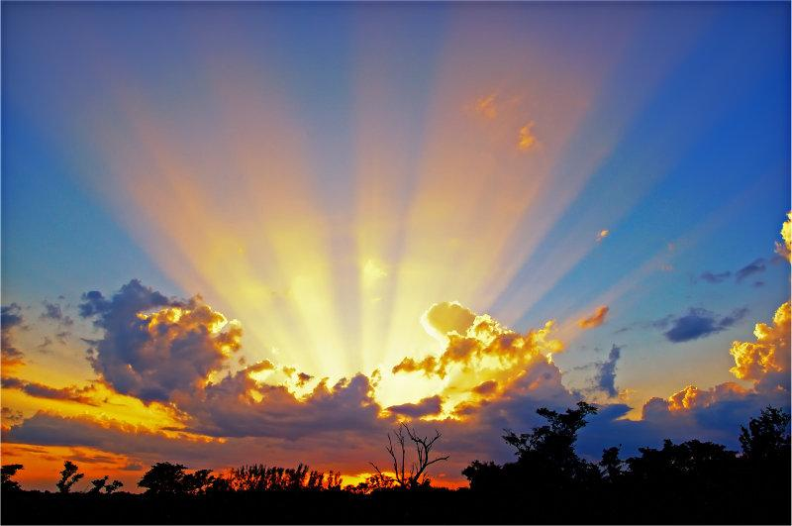
You came from Heaven to earth
To show the way.
From the Earth to the cross,
My debt to pay.
From the cross to the grave,
From the grave to the sky;
Lord, I lift Your name on high.

Slide 4
Lord, I lift Your name on high.
Lord, I love to sing Your praises.
I'm so glad You're in my life;
I'm so glad You came to save us.

Slide 5
You came from Heaven to earth
To show the way.
From the Earth to the cross,
My debt to pay.
From the cross to the grave,
From the grave to the sky;
Lord, I lift Your name on high.
(x2)

Slide 6
主は良いお方 (Shu wa yoi okata)

Slide 7

わが魂 主をたたえよ
Waga tamashii Shu wo tataeyo
聖なる御名を ほめたたえよ
Seinarumina wo hometataeyo
主の良くしてくださったことを
何一つ忘れるな
Shuno yokushite kudasattakotowo
Nanihitotsu wasureruna

Slide 8
わが魂 主をたたえよ
Waga tamashii Shu wo tataeyo
聖なる御名を ほめたたえよ
Seinarumina wo hometataeyo
主の良くしてくださったことを
何一つ忘れるな
Shuno yokushite kudasattakotowo
Nanihitotsu wasureruna

Slide 9
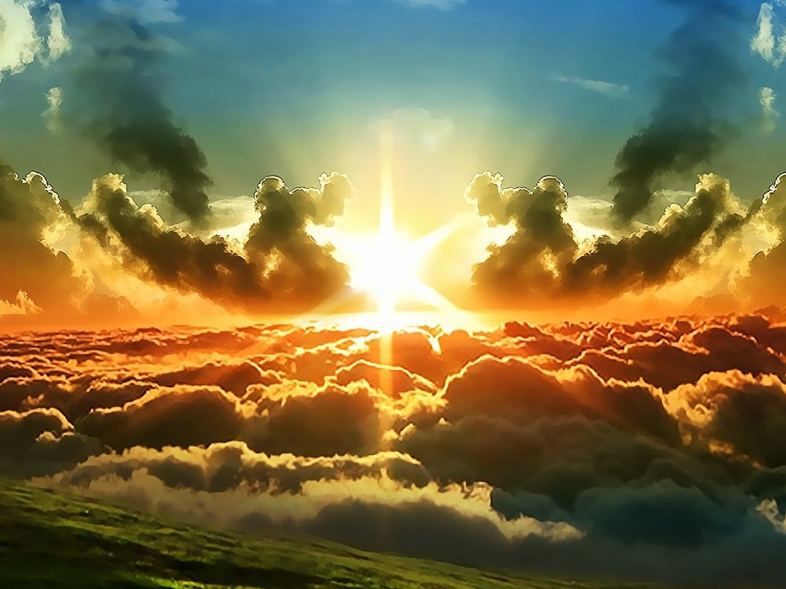
主は良いお方 主は良いお方
Shuwa yoiokata Shuwa yoiokata
恵みと憐れみの冠をもって
Megumi to awaremino kammuriwo motte
私の一生 良いもので満たす
Watashino issho yoimonode mitasu
主は良いお方 賛美をささげます
Suwa yoiokata sambiwo sasagemasu

Slide 10
わが魂 主をたたえよ
Waga tamashii Shu wo tataeyo
聖なる御名を ほめたたえよ
Seinarumina wo hometataeyo
主の良くしてくださったことを
何一つ忘れるな
Shuno yokushite kudasattakotowo
Nanihitotsu wasureruna

Slide 11
主は良いお方 主は良いお方
Shuwa yoiokata Shuwa yoiokata
恵みと憐れみの冠をもって
Megumi to awaremino kammuriwo motte
私の一生 良いもので満たす
Watashino issho yoimonode mitasu
主は良いお方 賛美をささげます
Suwa yoiokata sambiwo sasagemasu

Slide 12
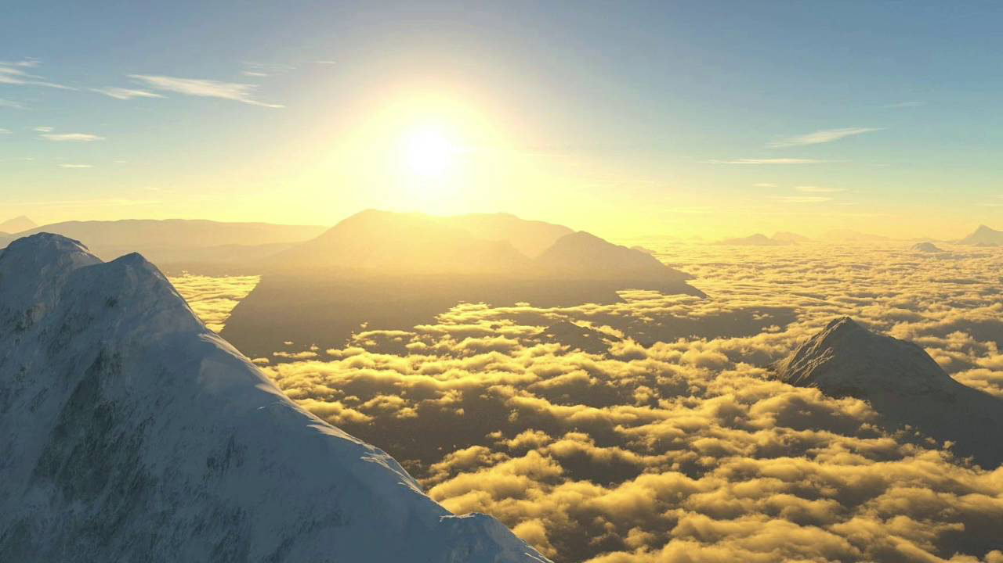
His goodness is forevermore
His goodness is forevermore
The One who redeems,
your life from the pit,
Who crowns you
with steadfast love

Slide 13
His goodness is forevermore
Who satisfies your life with good.
Bless the Lord, O my soul
His goodness is forevermore (x2)

Slide 14
Amazing grace

Slide 15

Amazing grace How sweet the sound That saved a wretch like me I once was lost, but now I am found Was blind, but now I see.
驚くばかりの 恵みなりき
この身のけがれを 知れるわれに
Notes:
15

Slide 16

'Twas grace that taught my heart to fear And grace my fears relieved How precious did that grace appear The hour I first believed.
恵みはわが身の 恐れを消し
まかする心を おこさせたり
Notes:
16

Slide 17

My chains are gone I've been set free My God, my Savior has ransomed me And like a flood His mercy reigns Unending love, Amazing grace
私の罪、咎 あなたは自由に
限りのない愛 溢れる恵みよ
Notes:
17

Slide 18

The Lord has promised good to me His word my hope secures He will my shield and portion be As long as life endures
危険をも罠をも 避け得たるは
恵みの御業と 言う他なし
Notes:
18

Slide 19

My chains are gone I've been set free My God, my Savior has ransomed me And like a flood His mercy reigns Unending love, Amazing grace (x2)
私の罪、咎 あなたは自由に
限りのない愛 溢れる恵みよ
Notes:
19

Slide 20
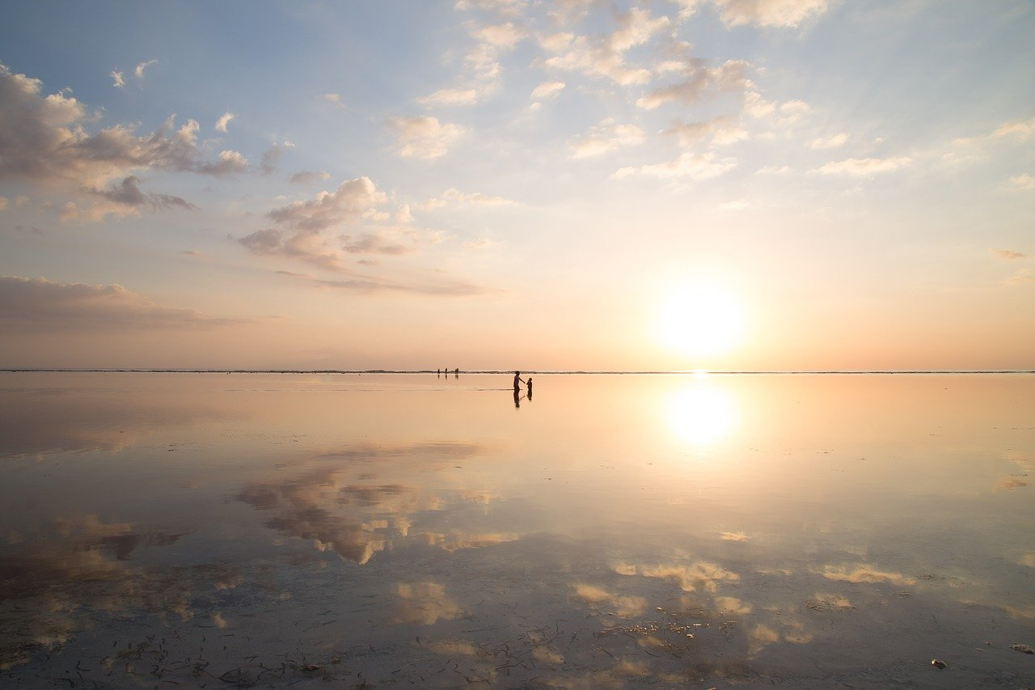
The earth shall soon dissolve like snow
The sun forbear to shine
But God who called me here below
Will be forever mine
Will be forever mine
You are forever mine
Notes:
20

Slide 21
Kansha Seyo

Slide 22
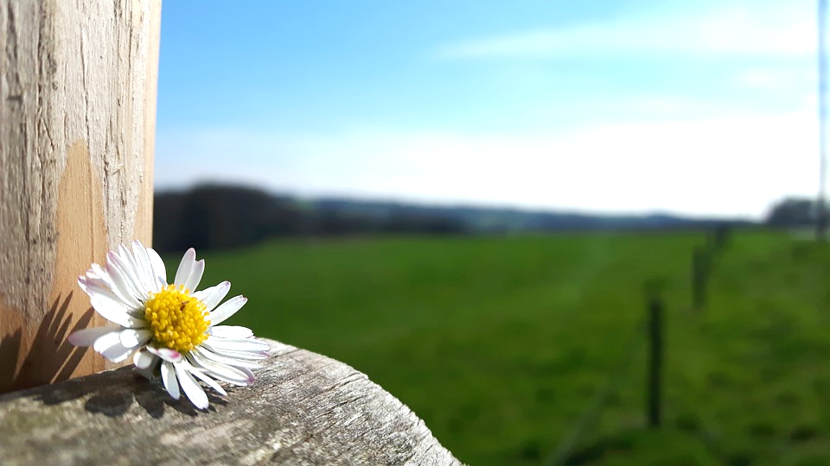
神を仰ぎ見て Kami wo agogi mite
賛美の声あげよ Sambi no koe ageyo
おそれるな おじけるな Osoreru na ojikeru na
神が共におられる Kami ga tomo ni orareru
(x2)

Slide 23

感謝せよ 感謝せよ Kansha seyo Kansha seyo
その恵みはとこしえまで Sono Megumi wa tokoshie made (x2)

