Slide 1


Slide 2
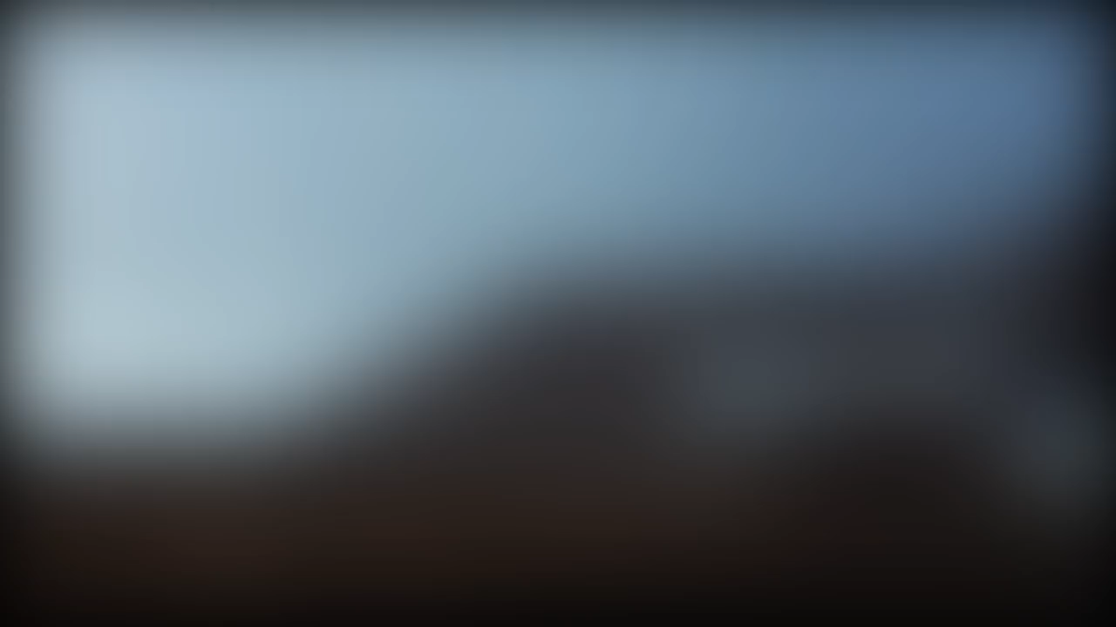

Slide 3


Slide 4
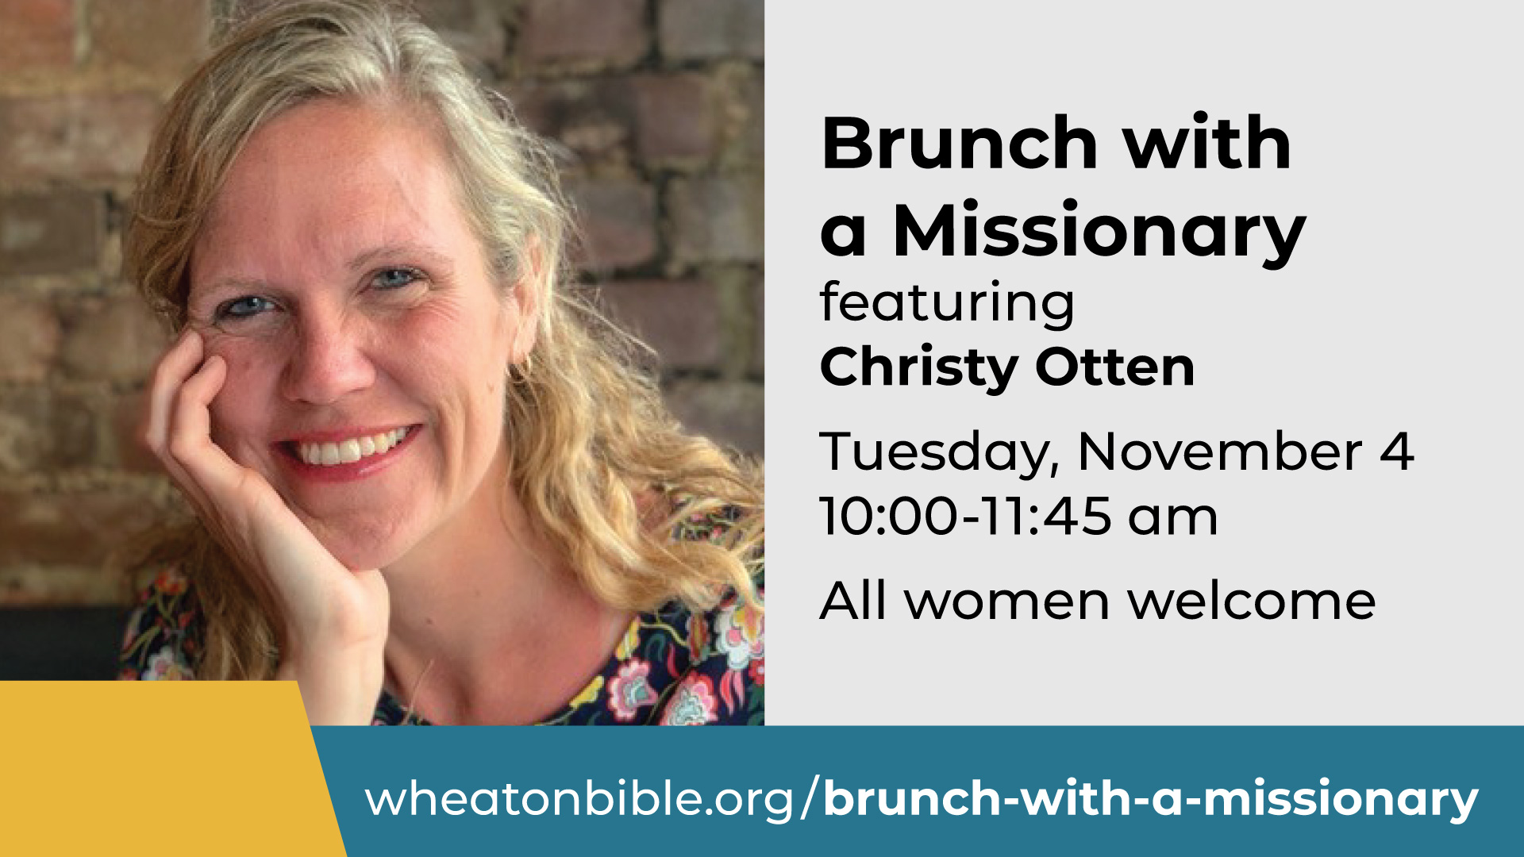

Slide 5


Slide 6
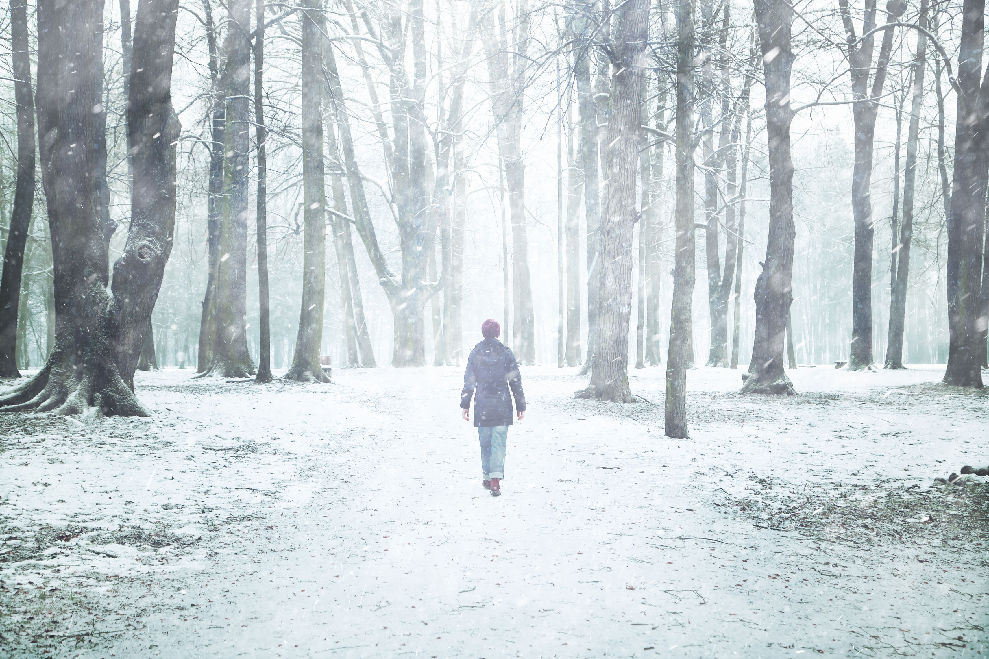
Surviving the Holidays
Help and hope as you navigate the holiday season
Thursday, November 6th - 6:30-8:30pm
One night – two events!
Practical help for those dealing with the aftermath of divorce or separation and for those who are grieving a loved one’s death.

Slide 7
Teacher: Ita Fischer
Steadfast
Obedience

Slide 8
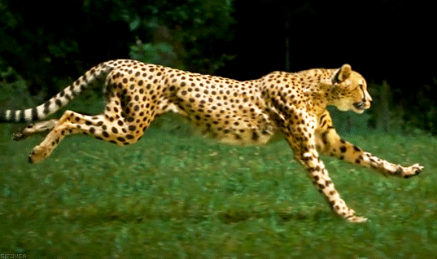

Slide 9
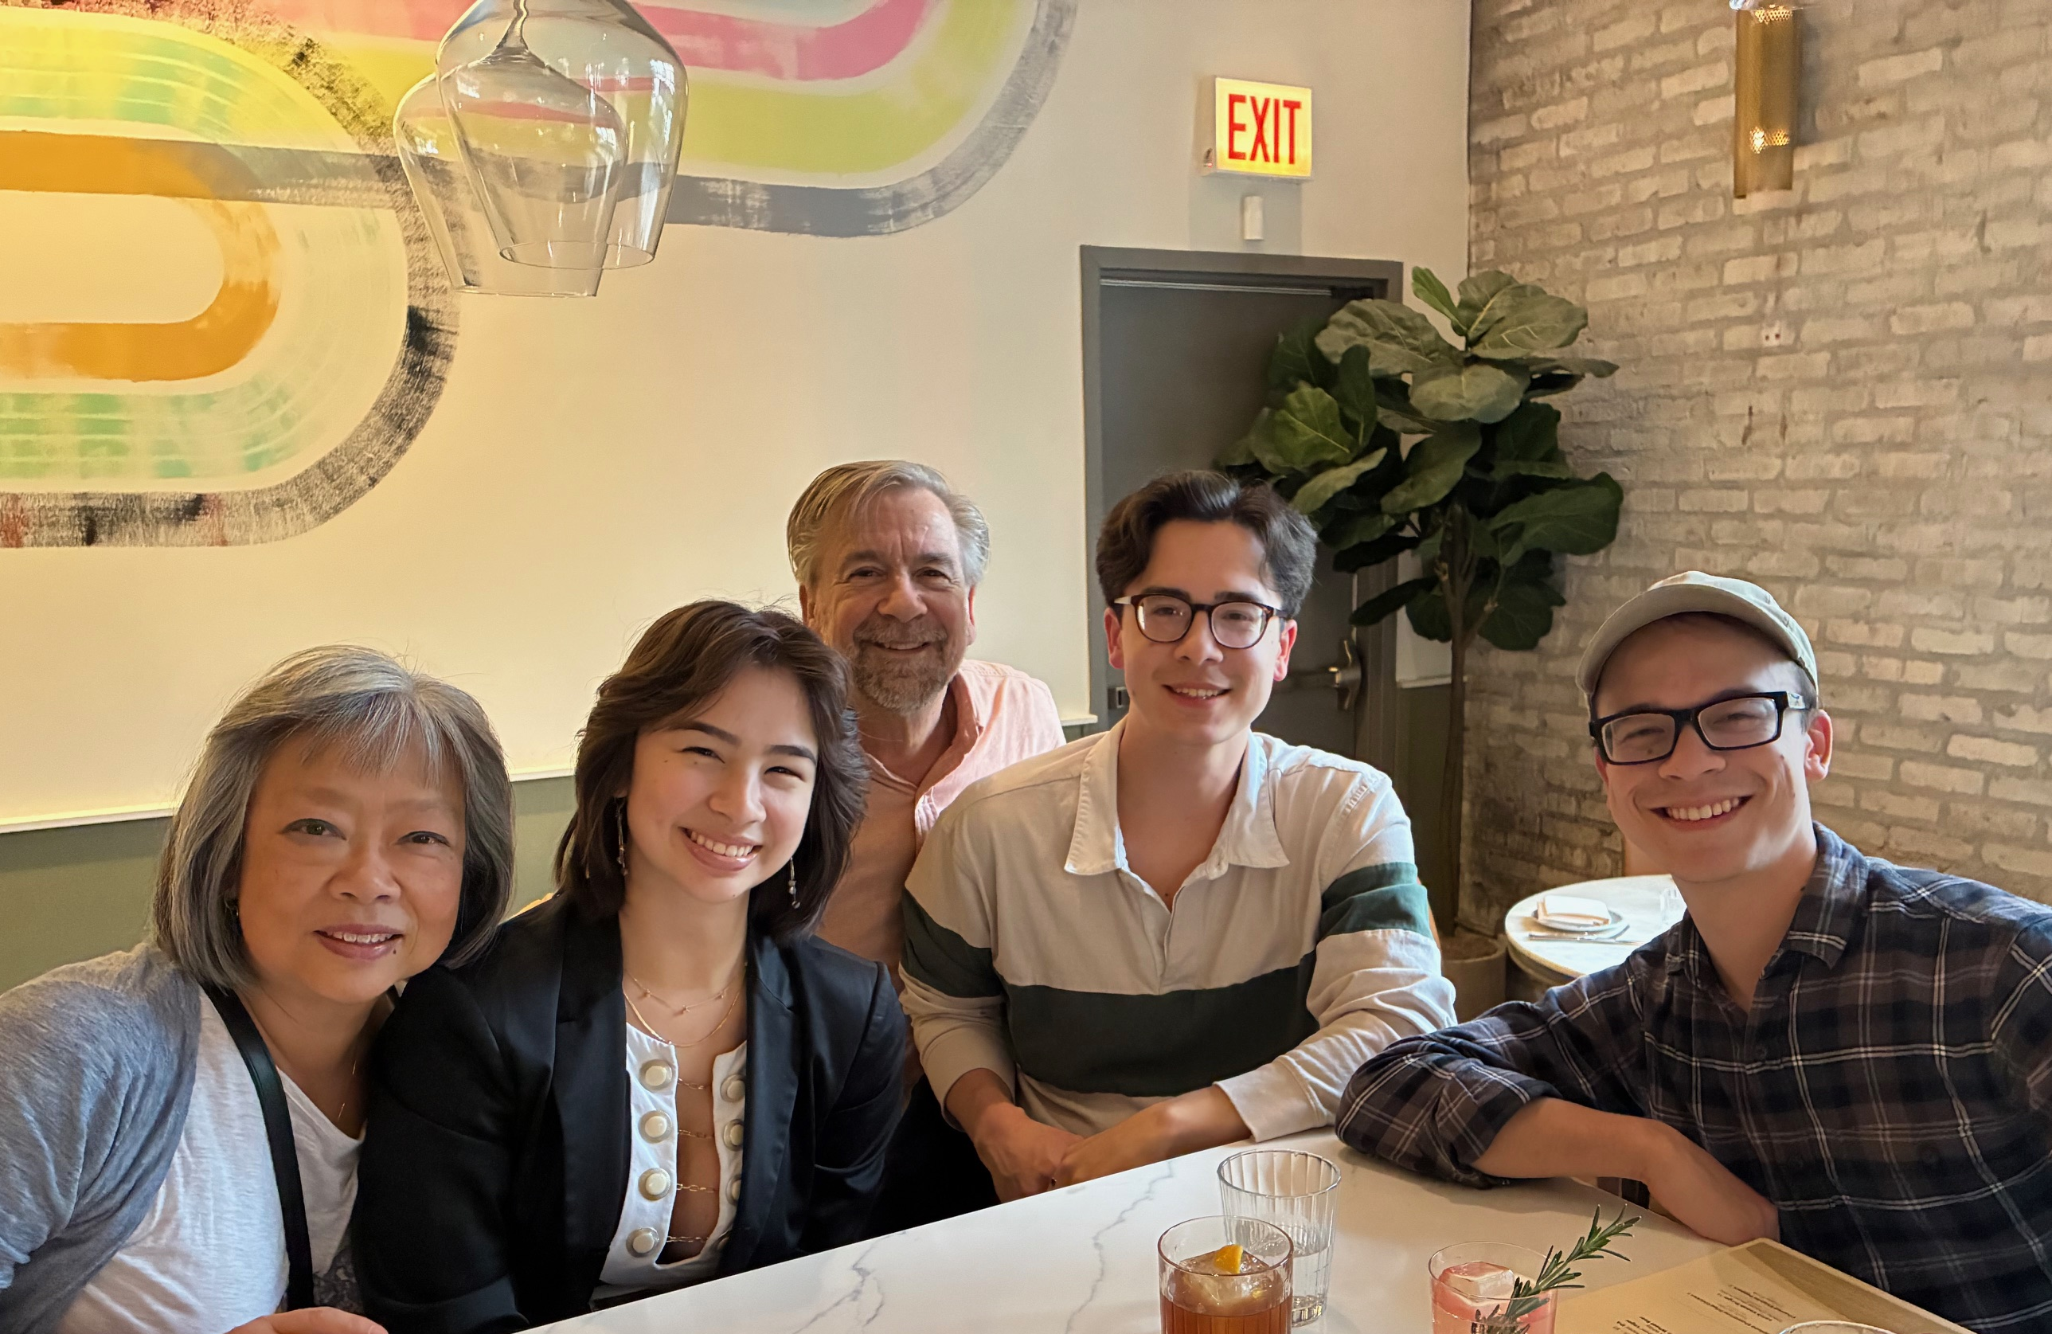
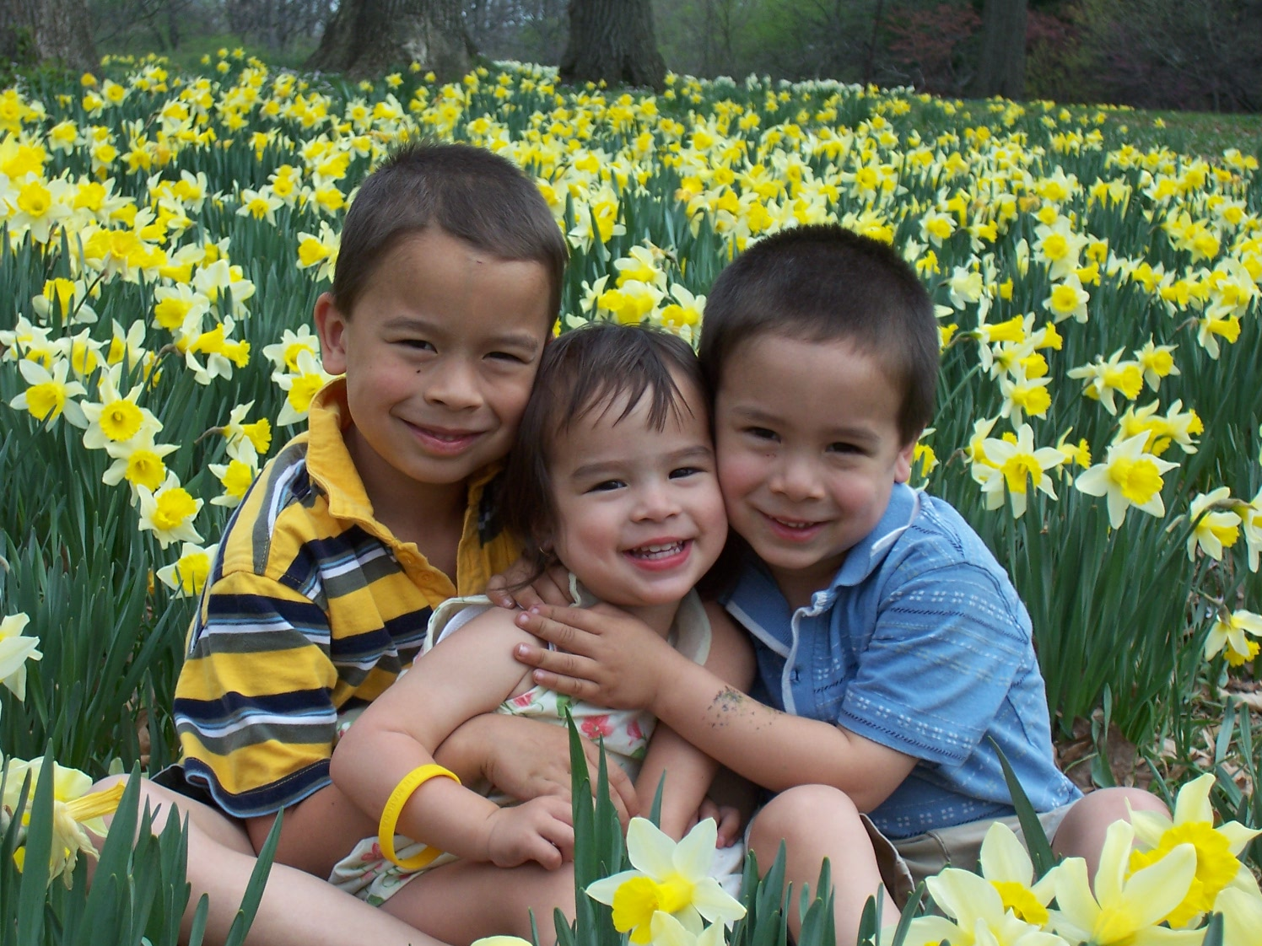

Slide 10
HOPE

Slide 11

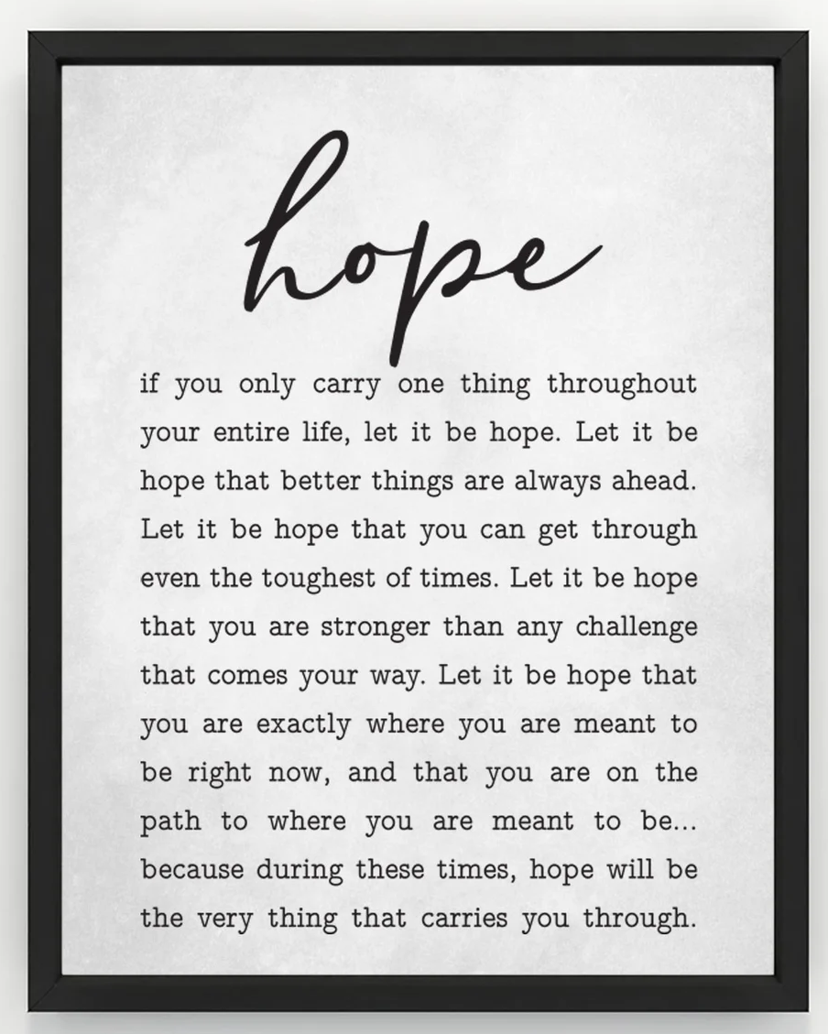
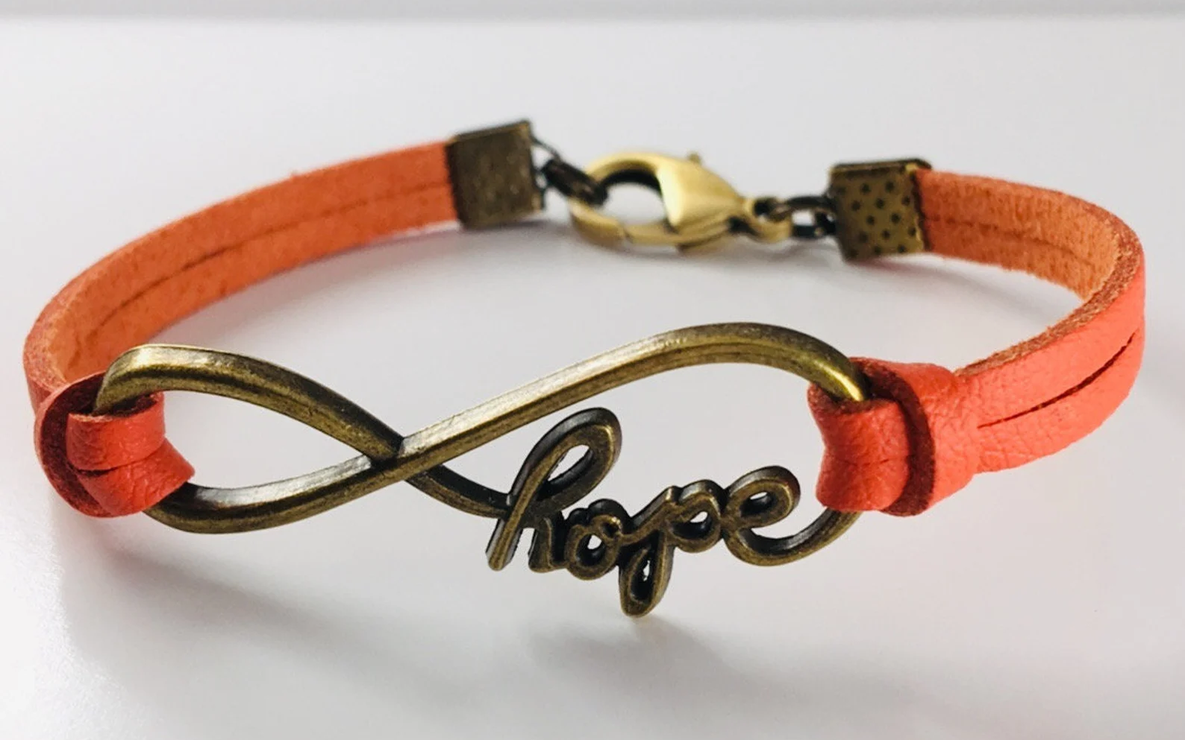
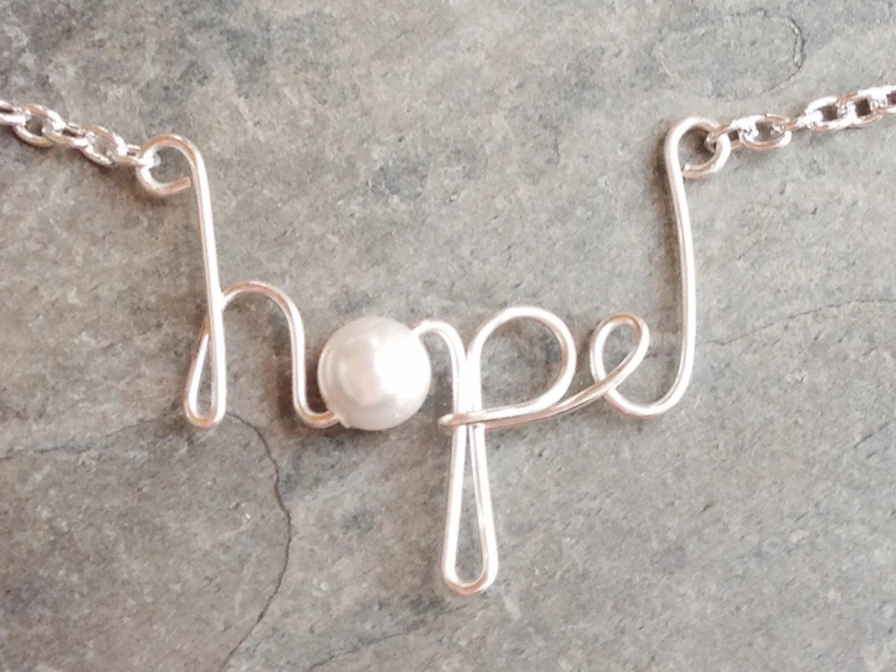

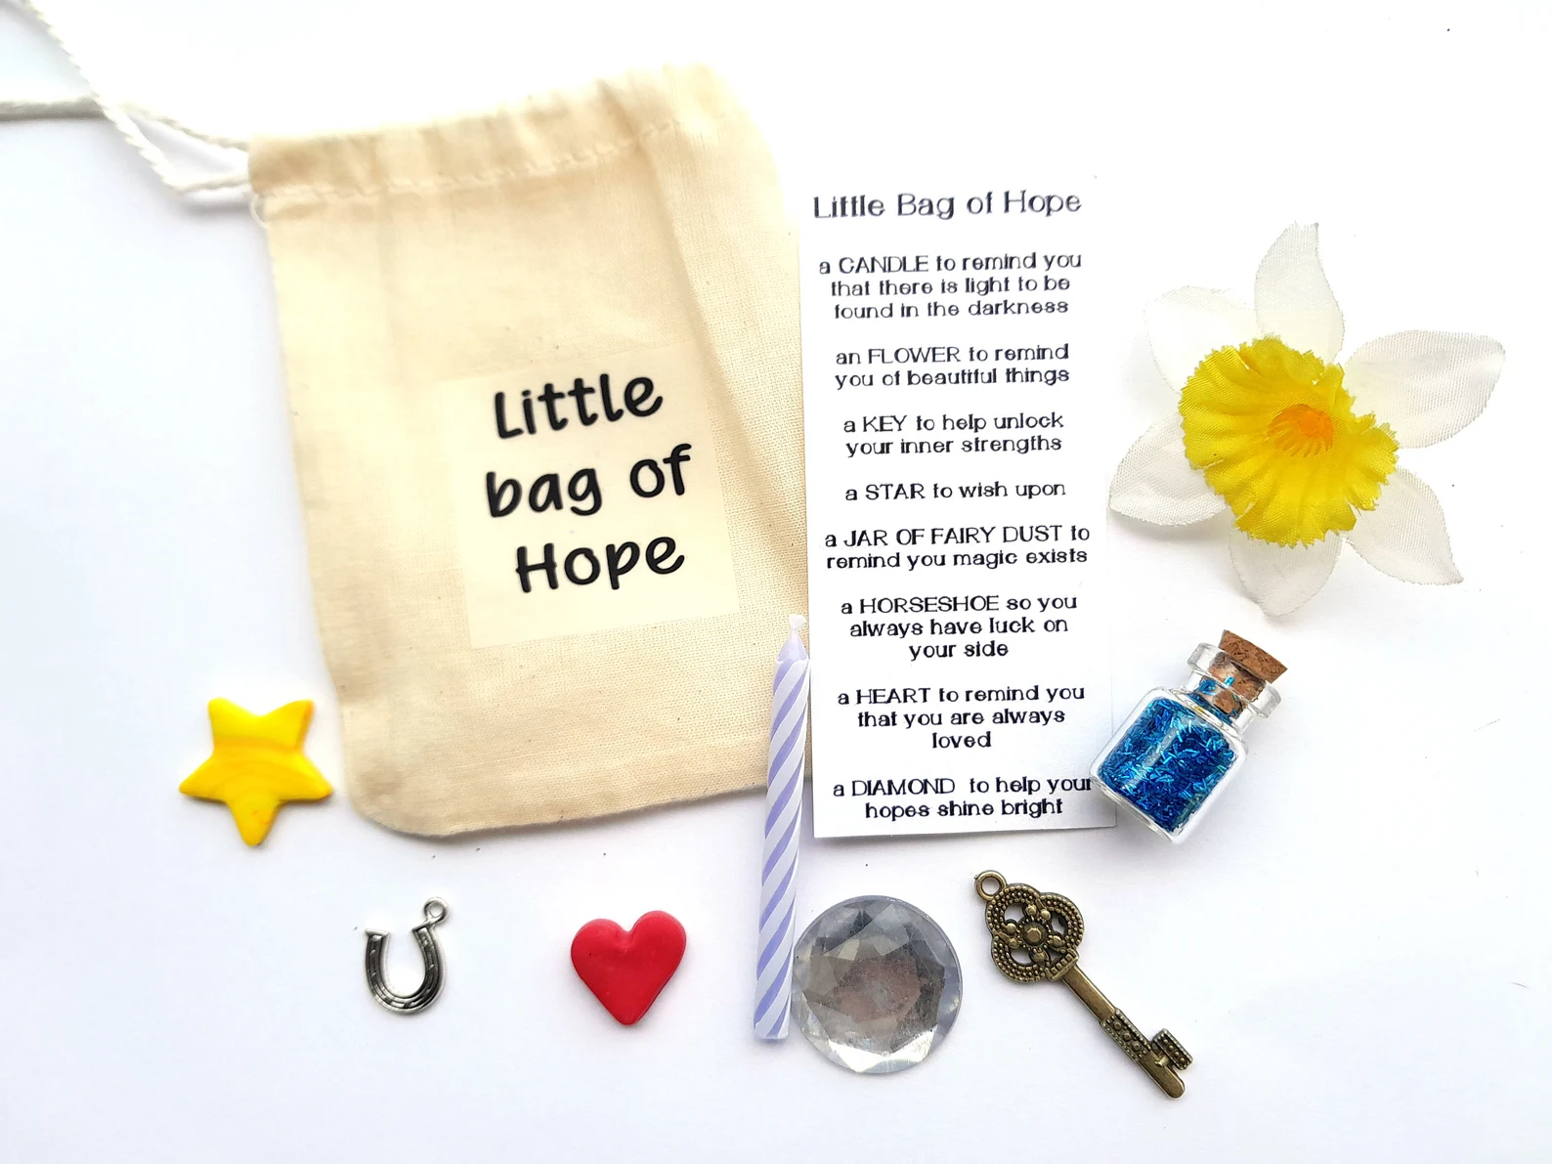



Slide 12
James 5:7-11
⁷ Be patient, therefore, brothers, until the coming of the Lord. See how the farmer waits for the precious fruit of the earth, being patient about it, until it receives the early and the late rains. ⁸ You also, be patient. Establish your hearts, for the coming of the Lord is at hand. ⁹ Do not grumble against one another, brothers, so that you may not be judged; behold, the Judge is standing at the door. ¹⁰ As an example of suffering and patience, brothers, take the prophets who spoke in the name of the Lord. ¹¹ Behold, we consider those blessed who remained steadfast. You have heard of the steadfastness of Job, and you have seen the purpose of the Lord, how the Lord is compassionate and merciful.
Leader: This is the Word of the Lord
People: Thanks be to God

Slide 13
Steadfast Hope
What Hope is (and what it’s not)
The Path to Hope
Steadfast Hope

Slide 14
Hope
(Verb) To wish for a particular event that one considers possible
(Noun) The longing or desire for something accompanied by the belief in the possibility of its occurrence.

Slide 15
Philippians 4:19
“And my God will meet all your needs according to the riches of his glory in Christ Jesus.”

Slide 16
I John 3:1
See what great love the Father has lavished on us that we should be called children of God! And that is what we are!

Slide 17
“People make things happen. All the rest is just window dressing.”
Oprah Winfrey

Slide 18
Hope
(Verb) To wish for a particular event that one considers possible
(Noun) The longing or desire for something accompanied by the belief in the possibility of its occurrence.

Slide 19
Luke 1:37
“For nothing will be impossible with God.”

Slide 20
Steadfast Hope
What Hope is (and what it’s not)
The Path to Hope
Steadfast Hope

Slide 21
SUFFERING

Slide 22
Romans 5:3-5
Not only so, but we also glory in our sufferings, because we know that suffering produces perseverance; perseverance, character; and character, hope. And hope does not disappoint, because God’s love has been poured out into our hearts through the Holy Spirit, who has been given to us.

Slide 23
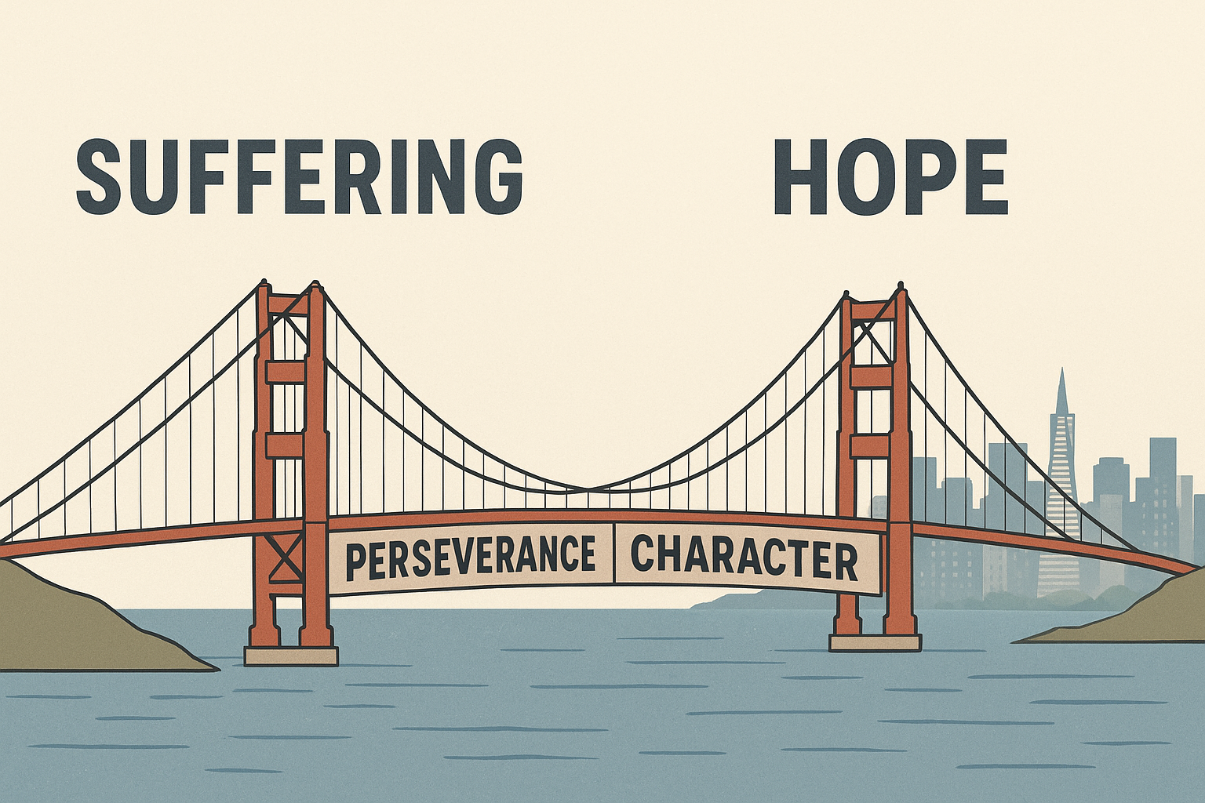

Slide 24
“…suffering is at the very heart of the Christian faith. It is not only the way Christ became like and redeemed us, but it is one of the main ways we become like him and experience his redemption. And that means that our suffering, despite its painfulness, is also filled with purpose and usefulness.”
Tim Keller
Walking with God through Pain and Suffering , p 5

Slide 25
Redemptive Suffering
There is a purpose to our season of suffering
Jesus is with you in your suffering

Slide 26
Reason for Suffering
“One of the main ways we move from abstract knowledge about God to a personal encounter with him as a living reality is through the furnace of affliction.”
Tim Keller
Walking with God through Pain and Suffering , p 5

Slide 27
Jesus is with you in your suffering
For I am convinced that neither death nor life, neither angels nor demons, neither the present nor the future, nor any powers, neither height nor depth, nor anything else in all creation, will be able to separate us from the love of God that is in Christ Jesus our Lord. Romans 8:38-39

Slide 28
Jesus is with you in your suffering
Come to me, all who labor and are heavy laden, and I will give you rest. Take my yoke upon you, and learn from me, for I am gentle and lowly in heart,and you will find rest for your souls.”
Matthew 11:28-30

Slide 29
Hope isn’t a possibility or a feeling…
Hope is a Person

Slide 30
God whispers to us in our pleasures, speaks in our conscience, but shouts in our pains: it is His megaphone to rouse a deaf world.
CS Lewis
The Problem of Pain p 91

Slide 31
“Suffering is unbearable if you aren’t certain that God is for you and with you.”
Tim Keller
Walking with God through Pain and Suffering , p 46

Slide 32
[Re-creation]…the repudiation of our former self, our fallen humanity, and the assumption of a new self or re-created humanity.
John Stott, The Message of Ephesians, p 180

Slide 33
…put off your old self, which belongs to your former manner of life and is corrupt through deceitful desires, and to be renewed in the spirit of your minds, and to put on the new self, created after the likeness of God in true righteousness and holiness.
Ephesians 4:22-23

Slide 34
Today’s suffering, is the training ground for Life Eternal

Slide 35
Steadfast Hope
What Hope is (and what it’s not)
The Path to Hope
Steadfast Hope

Slide 36
Romans 5:3-5
Not only so, but we also glory in our sufferings, because we know that suffering produces perseverance; perseverance, character; and character, hope.

Slide 37
Perseverance
ὑπομένω – hypomenō
“the strong, determined attitude with which we are to face difficult circumstances”
Douglas Moo PNTC James p 212

Slide 38
Romans 5:3-5
James 5:11
…suffering produces perseverance; perseverance, character; and character, hope…
we consider those blessed who remained steadfast. You have heard of the steadfastness of Job,

Slide 39
Steadfast (James 5:11)
ὑπομένω – hypomenō
Perseverance (Romans 5:3-5)
ὑπομένω – hypomenō

Slide 40
James 5:7-11
⁷ Be patient, therefore, brothers, until the coming of the Lord. See how the farmer waits for the precious fruit of the earth, being patient about it, until it receives the early and the late rains. ⁸ You also, be patient. Establish your hearts, for the coming of the Lord is at hand. ⁹ Do not grumble against one another, brothers, so that you may not be judged; behold, the Judge is standing at the door. ¹⁰ As an example of suffering and patience, brothers, take the prophets who spoke in the name of the Lord. ¹¹ Behold, we consider those blessed who remained steadfast. You have heard of the steadfastness of Job, and you have seen the purpose of the Lord, how the Lord is compassionate and merciful.

Slide 41
James brings out three points…
We should expect suffering as part of the human experience
The prophets suffered.
Even though they suffered, the blessing of God rested on them
Like Job, the Lord subjects his servants to those trials which call for steadfastness, because it is along this line that he wills to achieve his own purpose for them in some signal outpouring of his compassion and mercy.
James Motyer, The Message of James p 182-83

Slide 42
STEADFASTNESS

Slide 43
James 1:12
Blessed is the man who remains steadfast under trial, for when he has stood the test he will receive the crown of life, which God has promised to those who love him.

Slide 44
Human Hope rests on a Possibility.
Christian Hope rests on God’s Steadfastness.

Slide 45
The steadfast love of the Lord never ceases;
his mercies never come to an end;
they are new every morning;
great is your faithfulness.
Lamentations 3:22-23

Slide 46
“We are not to set our hope upon the things of this world, but on the unfailing promises of God, which endure forever.”
Charles Spurgeon
Metropolitan Tabernacle Pulpit,
Semon #466

Slide 47
May the God of hope fill you with all joy and peace in believing, so that by the power of the Holy Spirit you may abound in hope.
Romans 15:13

Slide 48
HOMEWORK
Lesson 7 Steadfast Prayer

Slide 49


