Slide 1


Slide 2
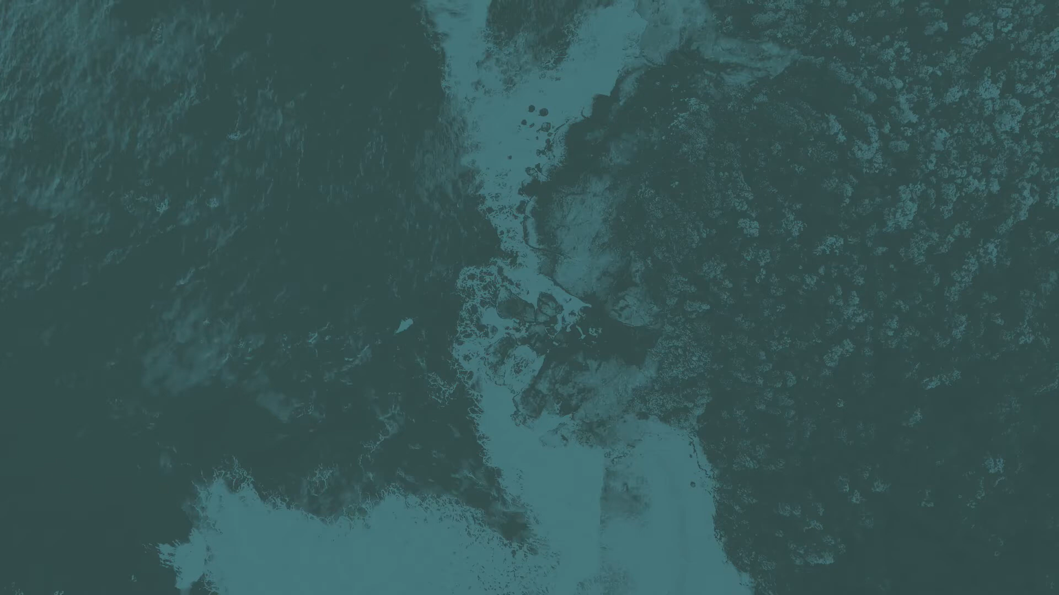

Slide 3


Slide 4

Opportunity to Give
Christmas Gift Drive
Bring a gift—new, unwrapped, and with a receipt*—for a child or teen (ages 6-18)
*Receipts are needed so we know the original prices to use when discounting the gifts.
P4Y Nov 4/5 - Nov 18/19
Sundays throughout November
Last day to give a gift is Sunday, December 7

Slide 5
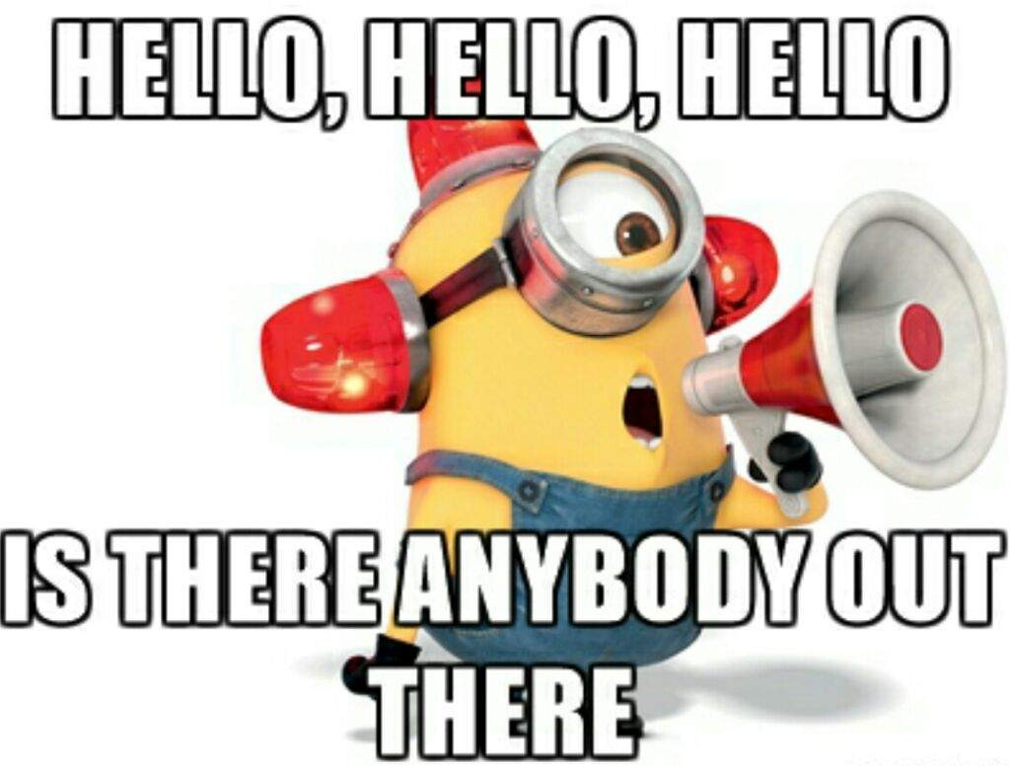
NOVEMBER 18-19 Do you know where your group meets?

Slide 6
HOMEWORK
Chapter 8 Steadfast Review

Slide 7
Four reasons to pray:
When there is either trouble or joy
When there is sickness
When there is sin
When there is wandering

Slide 8
“When you see a sunbeam, you should trace it back to the sun. When we receive God’s good gifts in our lives, we aren’t supposed to say, ‘Thank you God, that was nice of you!’ But instead we ought to say: ‘This gift, this goodness that I am experiencing, it’s so wonderful! And who is it that produced this goodness in my life? Ah yes, it is God Himself!’” C. S. Lewis

Slide 9
They are to call the elders.

Slide 10
They are to call the elders. The elders come and pray.

Slide 11
They are to call the elders. The elders come and pray. They anoint with oil.

Slide 12
They are to call the elders. The elders come and pray. They anoint with oil. They pray in the name of the Lord.

Slide 13
We’re to ask in faith, without doubt, knowing that God gives generously to all without reproach. (James 1:5-6) We know that every good and every perfect gift is from above— from our Father of Lights (James 1:17) We’re to submit and humble ourselves before the Lord (James 4: 7, 10) We need to recognize how short this life really is—we are all a mist that appears for a little while and then vanishes. (James 4:14) We need to remember that the Lord is compassionate and merciful. (James 5:11)

Slide 14
2 Corinthians 12:9-10 But he said to me, “My grace is sufficient for you, for my power is made perfect in weakness.” Therefore, I will boast all the more gladly of my weaknesses, so that the power of Christ may rest upon me. For the sake of Christ, then, I am content with weaknesses, insults, hardships, persecutions, and calamities. For when I am weak, then I am strong.

Slide 15
Paul David Tripp:
“The heart of true prayer is vertical confession, not horizontal desire. Prayer is a confession in which I own my condition and embrace my need. I confess once again that I won’t ever be what I’m supposed to be and do what I am supposed to do without the forgiving, empowering and delivering grace of the One to whom I am praying.”

Slide 16
Colossians 3:12-14 “Therefore, as God’s chosen people, holy and dearly loved, clothe yourselves with compassion, kindness, humility, gentleness and patience. Bear with each other and forgive one another if any of you has a grievance against someone. Forgive as the Lord forgave you. And over all these virtues put on love, which binds them all together in perfect unity.”

Slide 17


