Slide 1


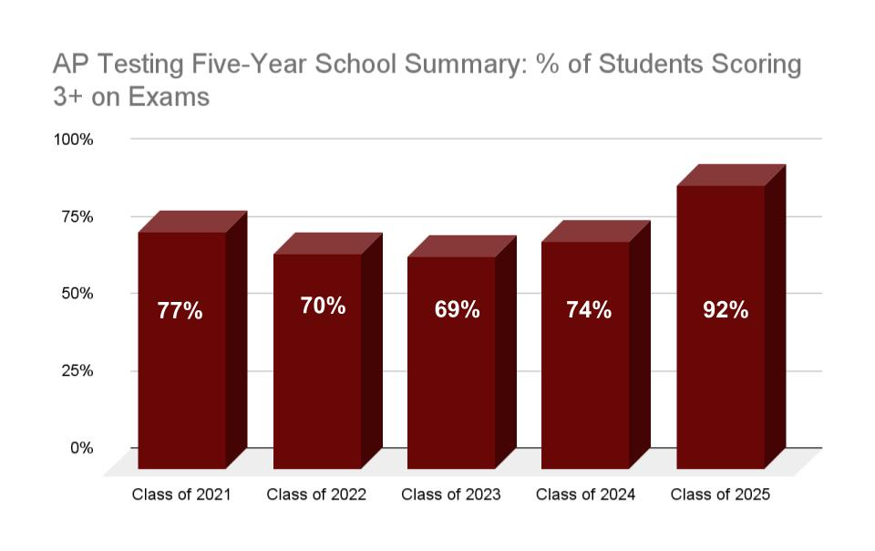
ACCREDITATION
Association of Christian Schools International (ACSI) in grades PreK-12
COGNIA (formally known as AdvancED) in grades K-12.
First Baptist Academy
HIGH SCHOOL PROFILE
2025-2026
3000 Orange Blossom Dr.
Naples, Florida 34109
Tel: 239.597.2233
www.fbalions.org
CEEB Code: 102101
FBA AT A GLANCE
College Preparatory, Christian School
High School established in 2006
FBA emphasizes the development of a biblical worldview.
246 Total College Acceptances (CO 2025)
Weekly Chapel
870 Students PK-12
251 High School Students
59 Seniors
62 AP Course Exams Taken (CO 2025)
$4.9 Million in earned scholarships (CO 2025)
37% Receiving Bright Futures Scholarship (CO 2025)
MISSION STATEMENT
To partner with parents to develop students with Christian character and a biblical worldview, equipping them for life, learning, and leadership.
CLASS OF 2025 Standardized Mean Scores CO 2025 Top 25%
ACT Composite Mean | 21.8 28.1
SAT ERW Mean | 578 692
SAT Math Mean | 554 660
PSAT/NMSQT Results
Since the graduating class of 2013 FBA has had 4 National Merit Finalists and 7 National Merit Commended Scholars.
Dr. Ryan Dupeé
Head of School
Mrs. Christina Wennlund High School Principal
Mrs. Leigh Anne Bates
Director of College and Career
lbates@fbalions.org
Mrs. Caroline Smith
Academic Counselor
csmith@fbalions.org

Slide 2
GRAD REQUIREMENTS -24 CREDITS
Social Sciences
Fine Arts
HOPE
Electives
Bible
English
Foreign Language
Mathematics
Sciences
4 credits
1 credit
1 credit
1 credit
4 credits
4 credits
2 credits
4 credits
3 credits
COURSE OFFERINGS
CHRISTIAN STUDIES
Foundations
Apologetics
Worldview
Culture
Dual Credit Old Testament Literature
Dual Credit New Testament Literature
ENGLISH
English 1
English 1 Honors
English 2
English 2 Honors
English 3
English 3 Honors
AP English Language
English 4
English 4 Honors
AP English Literature
FINE ARTS
AP 2D Art
Draw & Paint 1
Draw & Paint 2
Band/Band Honors
Choir/Choir Honors
Photoshop
Sculpture
Strings/Strings Honors
Theater
Visual Technology
Worship Team/WT Honors
Yearbook
FOREIGN LANGUAGE
Spanish 1
Spanish 2
Spanish 3
Spanish 3 Honors
Spanish 4 Honors
Dual Credit Spanish
GENERAL ELECTIVES
ACT/SAT prep
AP Computer Science
College & Career Connections
Critical Thinking Skills
Financial Literacy Honors
Intro to Engineering Design Honors
Intro To Law Honors
Marketing Essentials Honors
Psychology/Sociology Honors
Speech (Dual Credit option)
MATHEMATICS
Algebra I
Algebra I Honors
Geometry
Geometry Honors
Algebra 2
Algebra 2 Honors
AP Pre-Calculus
Dual Credit Calculus
Dual Credit Statistics
Math For College Algebra
Dual Credit College Algebra
PHYSICAL EDUCATION
Athletic Period
HOPE
SCIENCE
Biology
Biology Honors
Chemistry
Chemistry Honors
Conceptual Physics
Physics Honors
Dual Credit Biology
Anatomy & Physiology Honors
AP Environmental Science
SOCIAL STUDIES
World Geography
World Geography Honors
World History
World History Honors
Dual Credit World History
US History
US History Honors
Dual Credit US History
Government Honors
Economics Honors
Dual Credit Government
Dual Credit Microeconomics
Dual Credit Macroeconomics
GRADING SCALE
First Baptist Academy does not rank students. Honors courses are awarded an additional .5 quality point, and AP/Dual credit courses are awarded an additional 1.0 quality point.
A | 90-100 | 4.0
B | 80-89 | 3.0
C | 70-79 | 2.0
D | 60-69 | 1.0
F | 0-59 | 0

