Slide 1


Slide 2


Slide 3


Slide 4


Slide 5


Slide 6
1. Stated Authoritatively
Romans 8:1

Slide 7


Slide 8
2. Experienced Subjectively
Romans 8:2

Slide 9


Slide 10
3. Explained Objectively
Romans 8:3-4

Slide 11
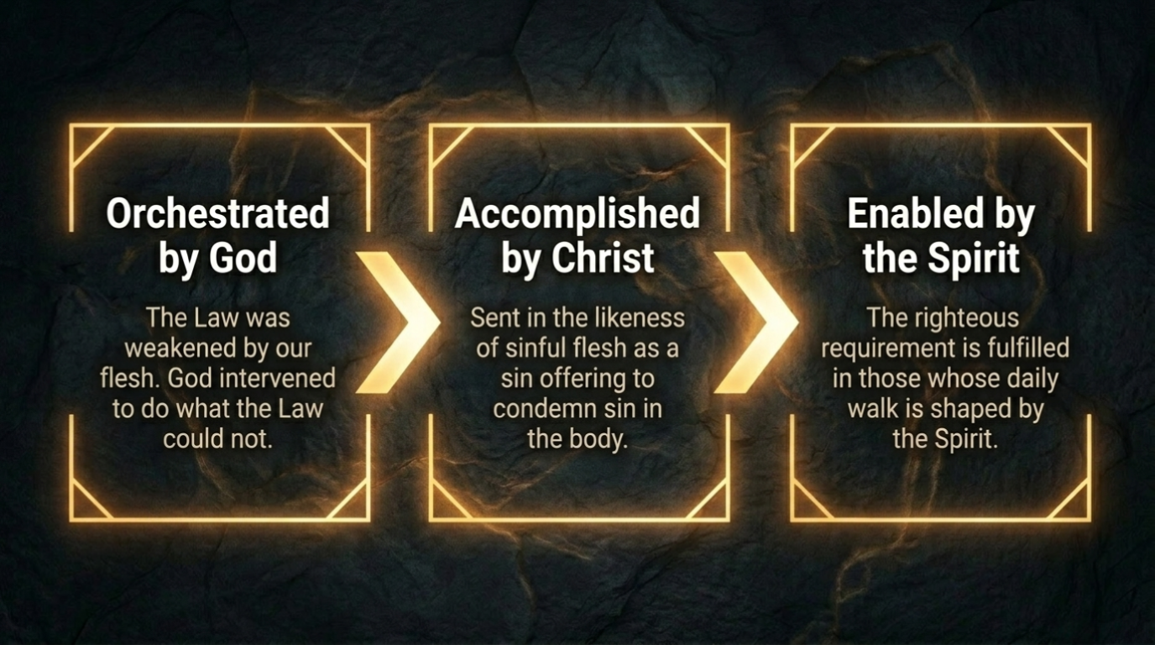

Slide 12
4. Described Contrastingly
Romans 8:5-8

Slide 13


Slide 14
5. Applied Personally
Romans 8:9

Slide 15


Slide 16
6. Defended Biblically
Romans 8:10-11

Slide 17
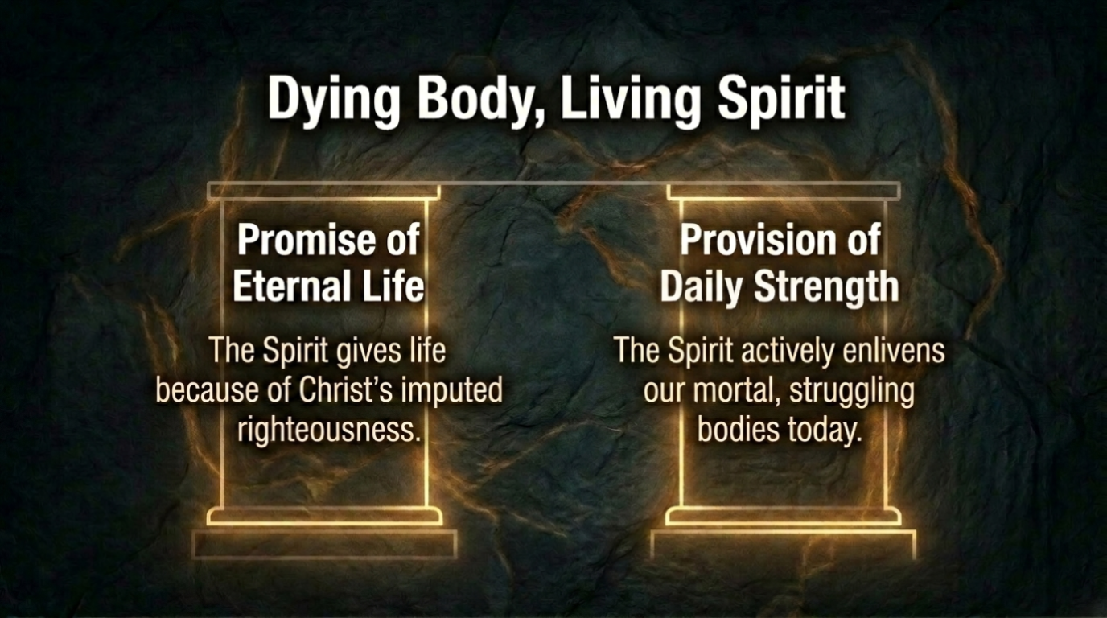

Slide 18


Slide 19


