Slide 1


Slide 2
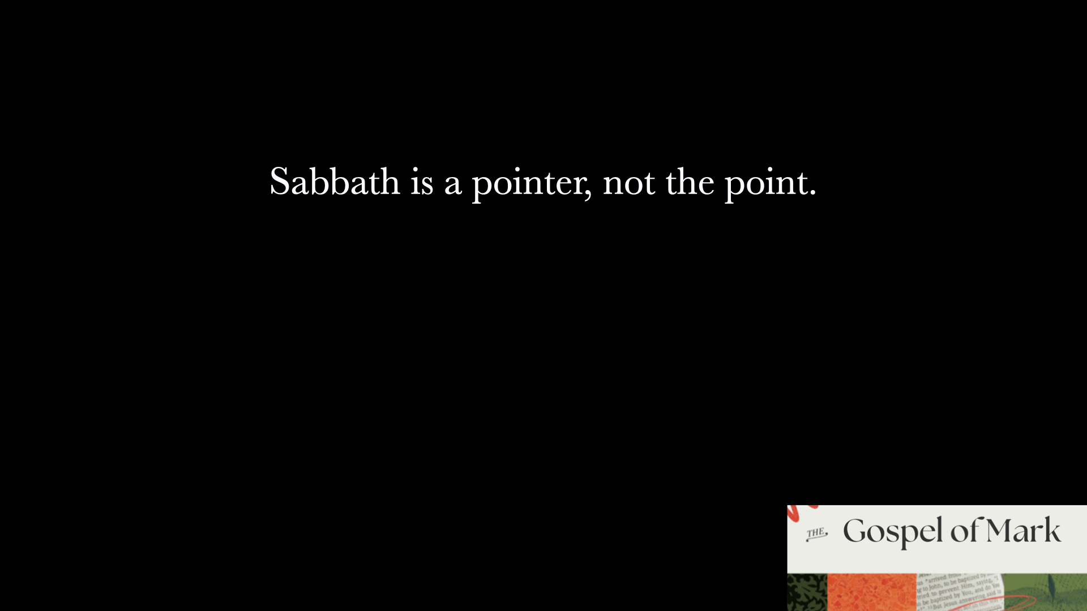
Zechariah 13:7
I will strike the shepherd and the sheep will be scattered.

Slide 3
The medical term for sweating blood is hematidrosis. It is a very rare condition where blood oozes from intact skin, commonly due to extreme physical or emotional stress, causing capillaries around sweat glands to rupture.

Slide 4
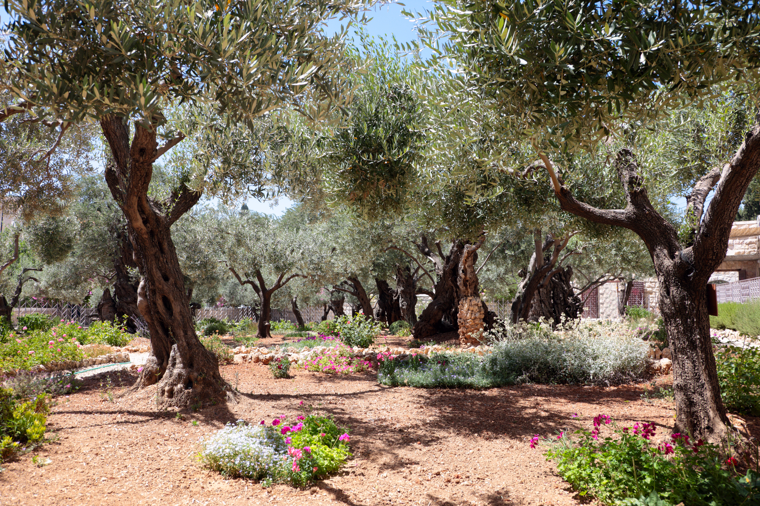
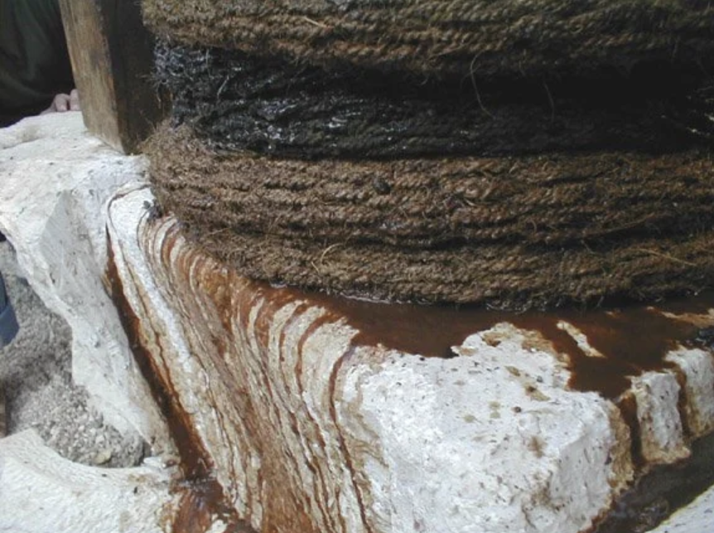
Olive Press
Gethsemane
Aramaic words “Geth”- press & “Semane”- oil

